Slide 1




Visual Merchandising
Brett Wolff
brett.wolff@uky.edu
Notes:
Getting the right product to the right customer, in the right place, at the right price.

Slide 2
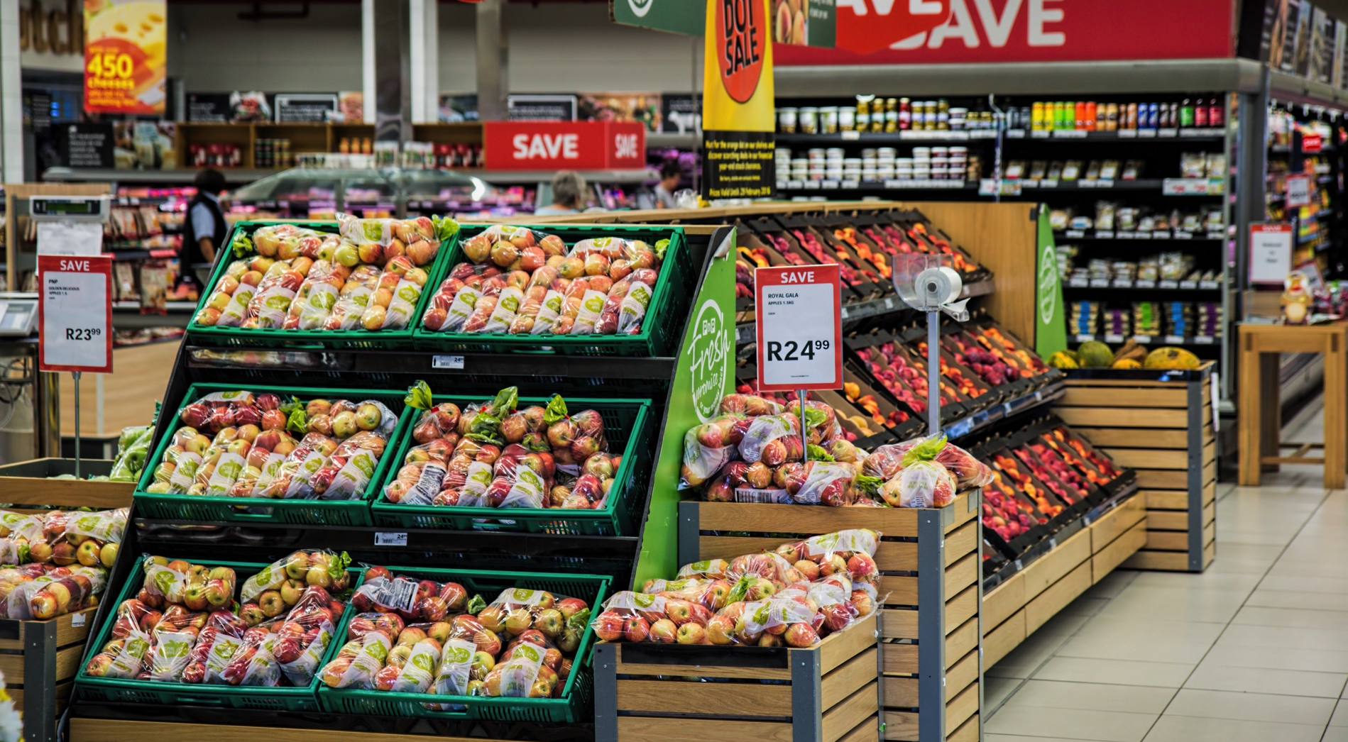
Clean & Neat

Slide 3
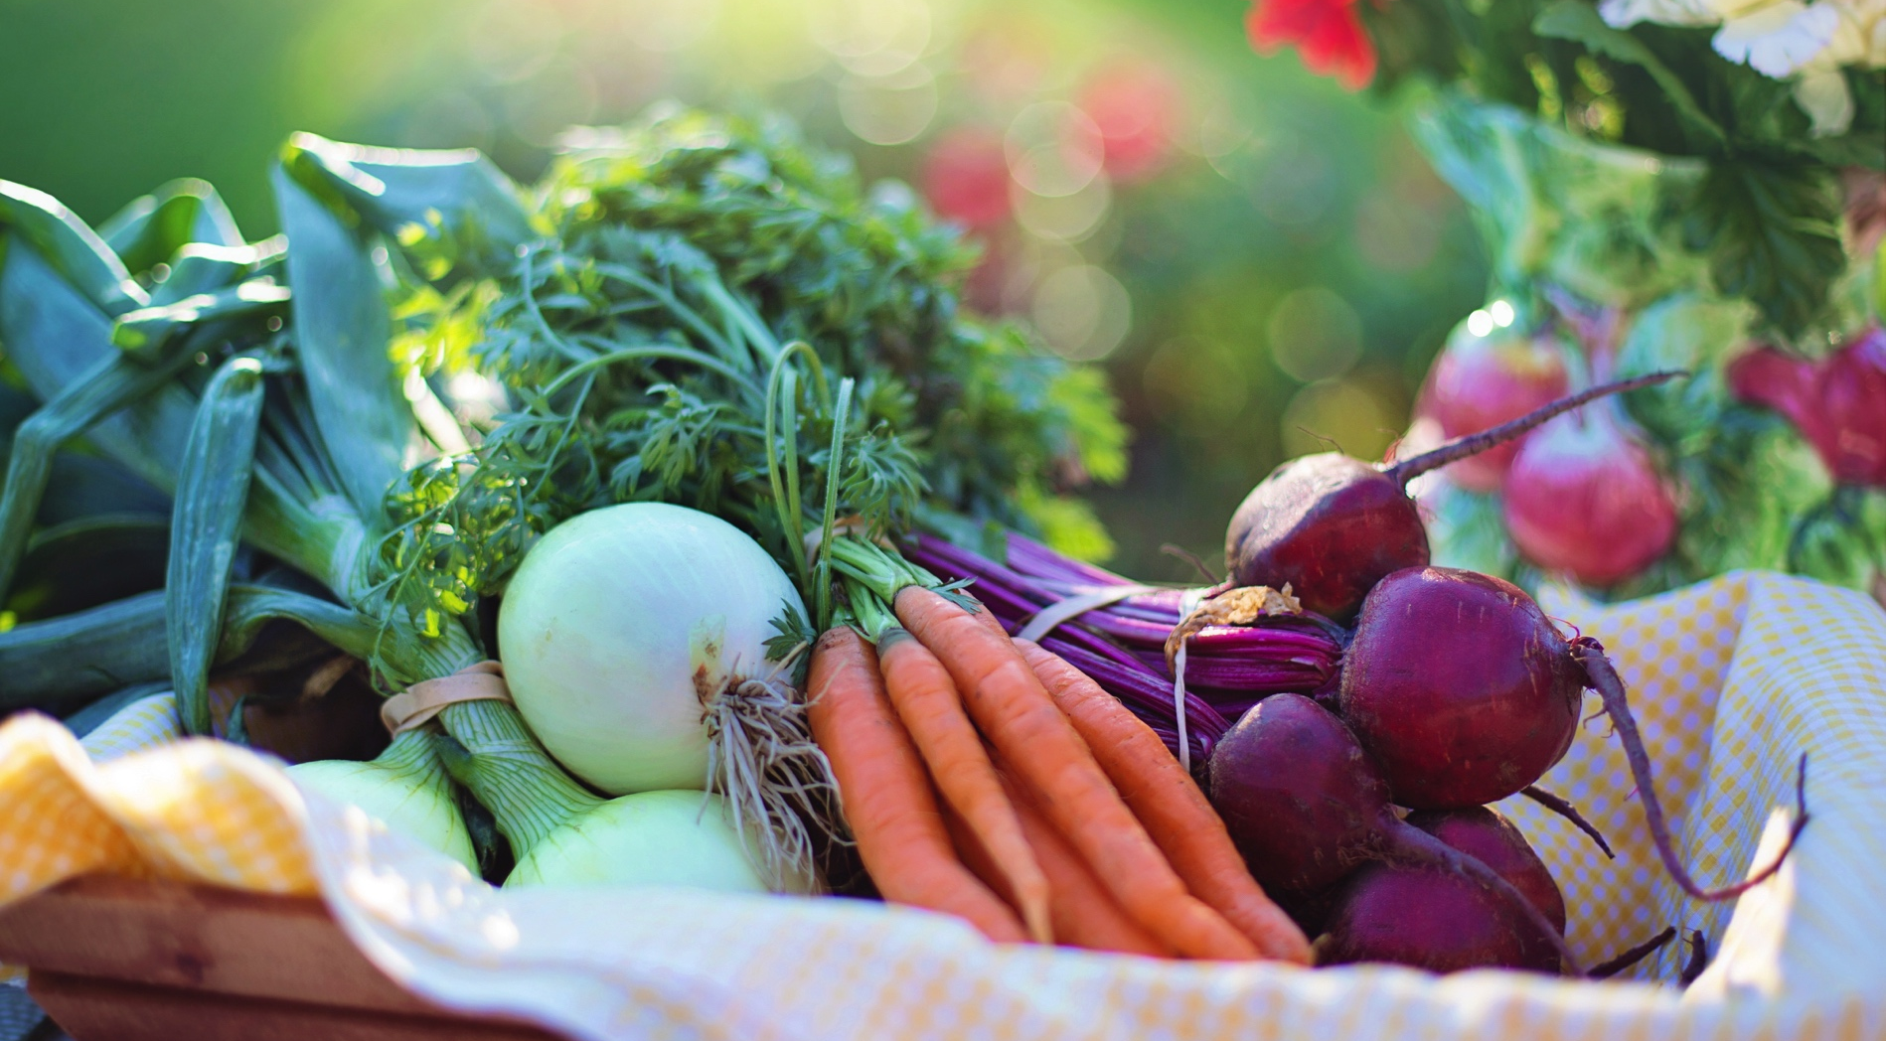
Product Quality

Slide 4



You

Slide 5
Floorplan & Flow

Slide 6


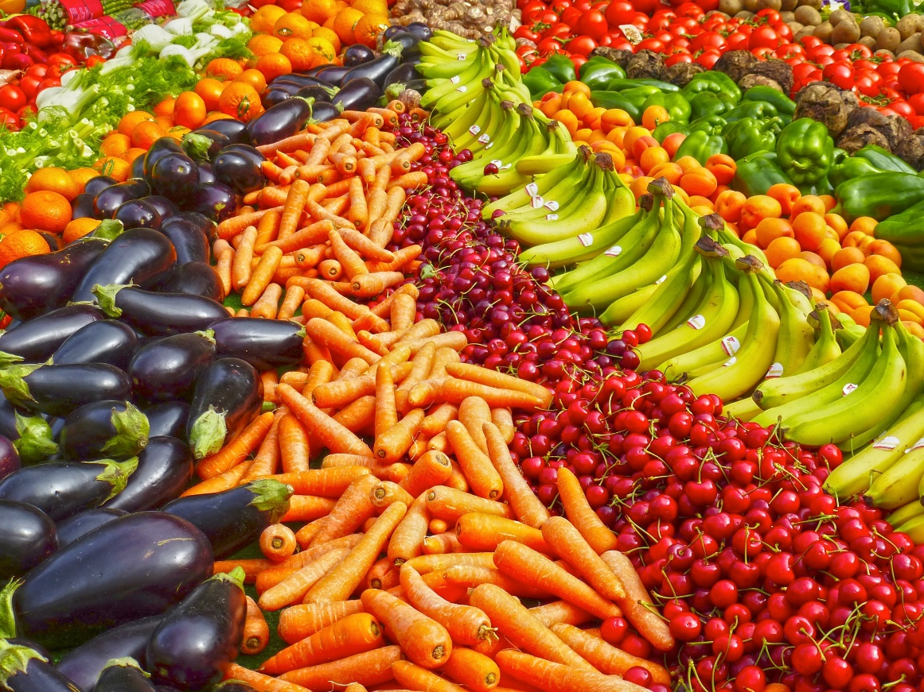
Visuals

Slide 7
Clean & Neat

Slide 8
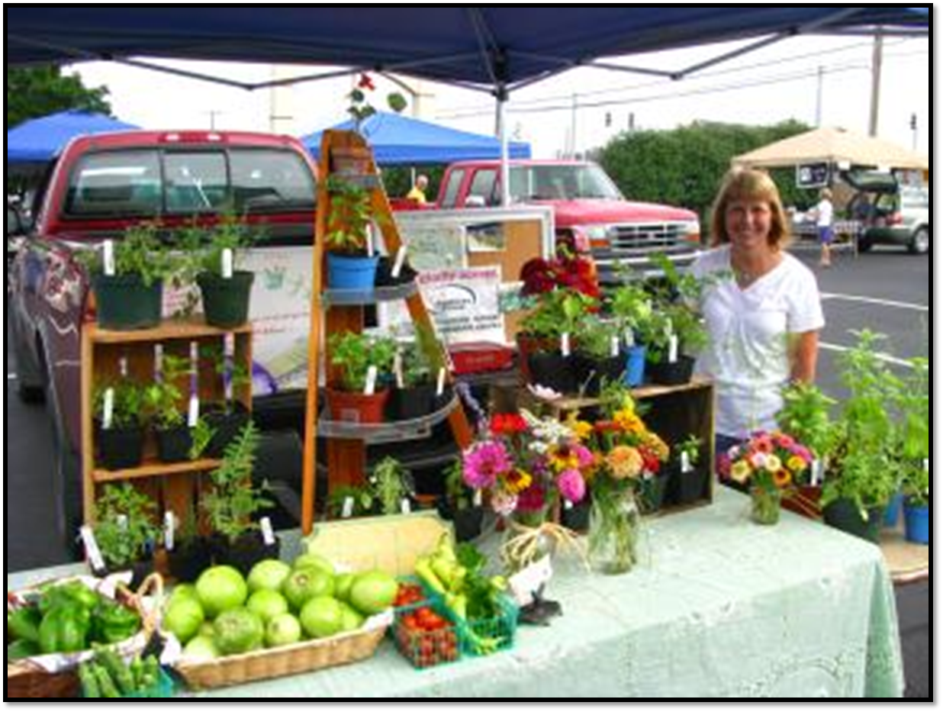
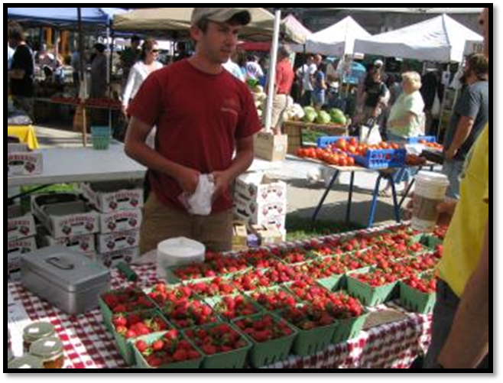
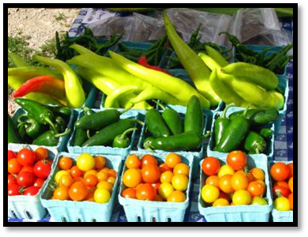
Vertical dimension
Abundance
Color

Slide 9
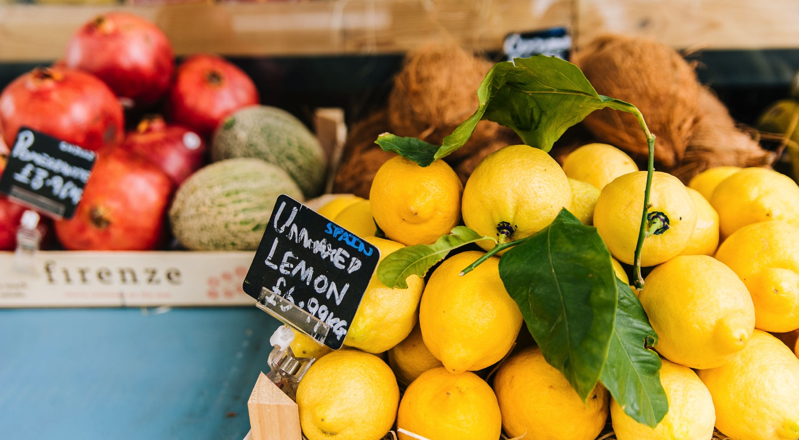
Signs

Slide 10
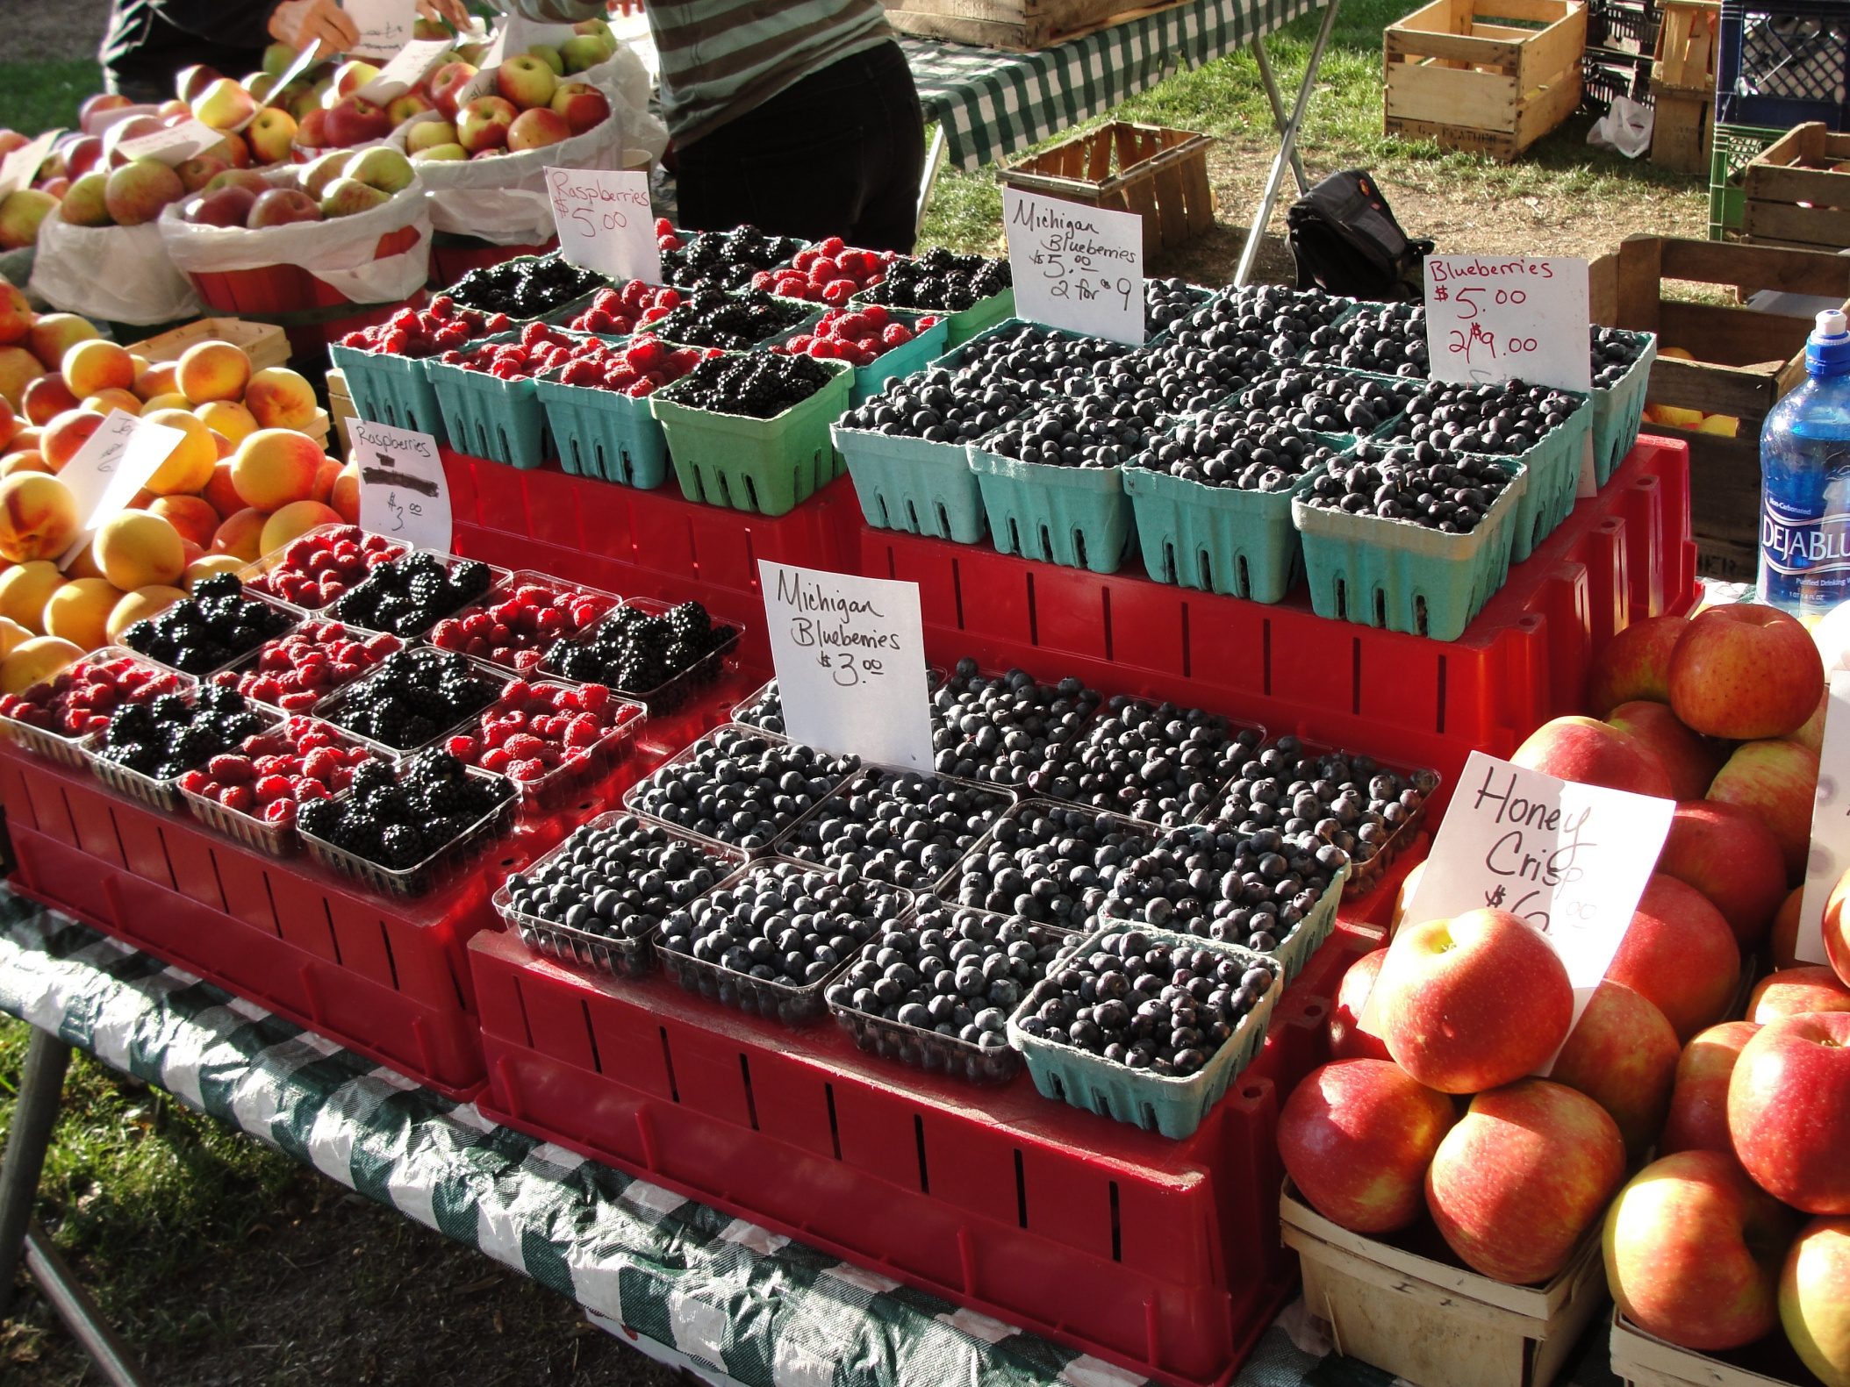

Slide 12

Signs

Slide 13
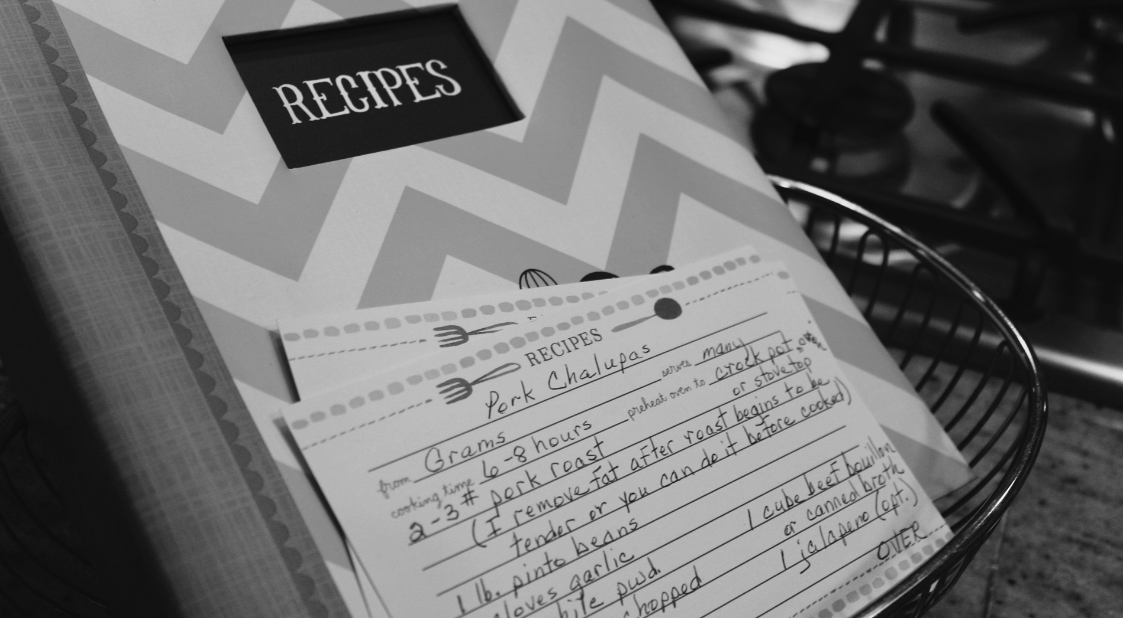
Take-Homes

Slide 14
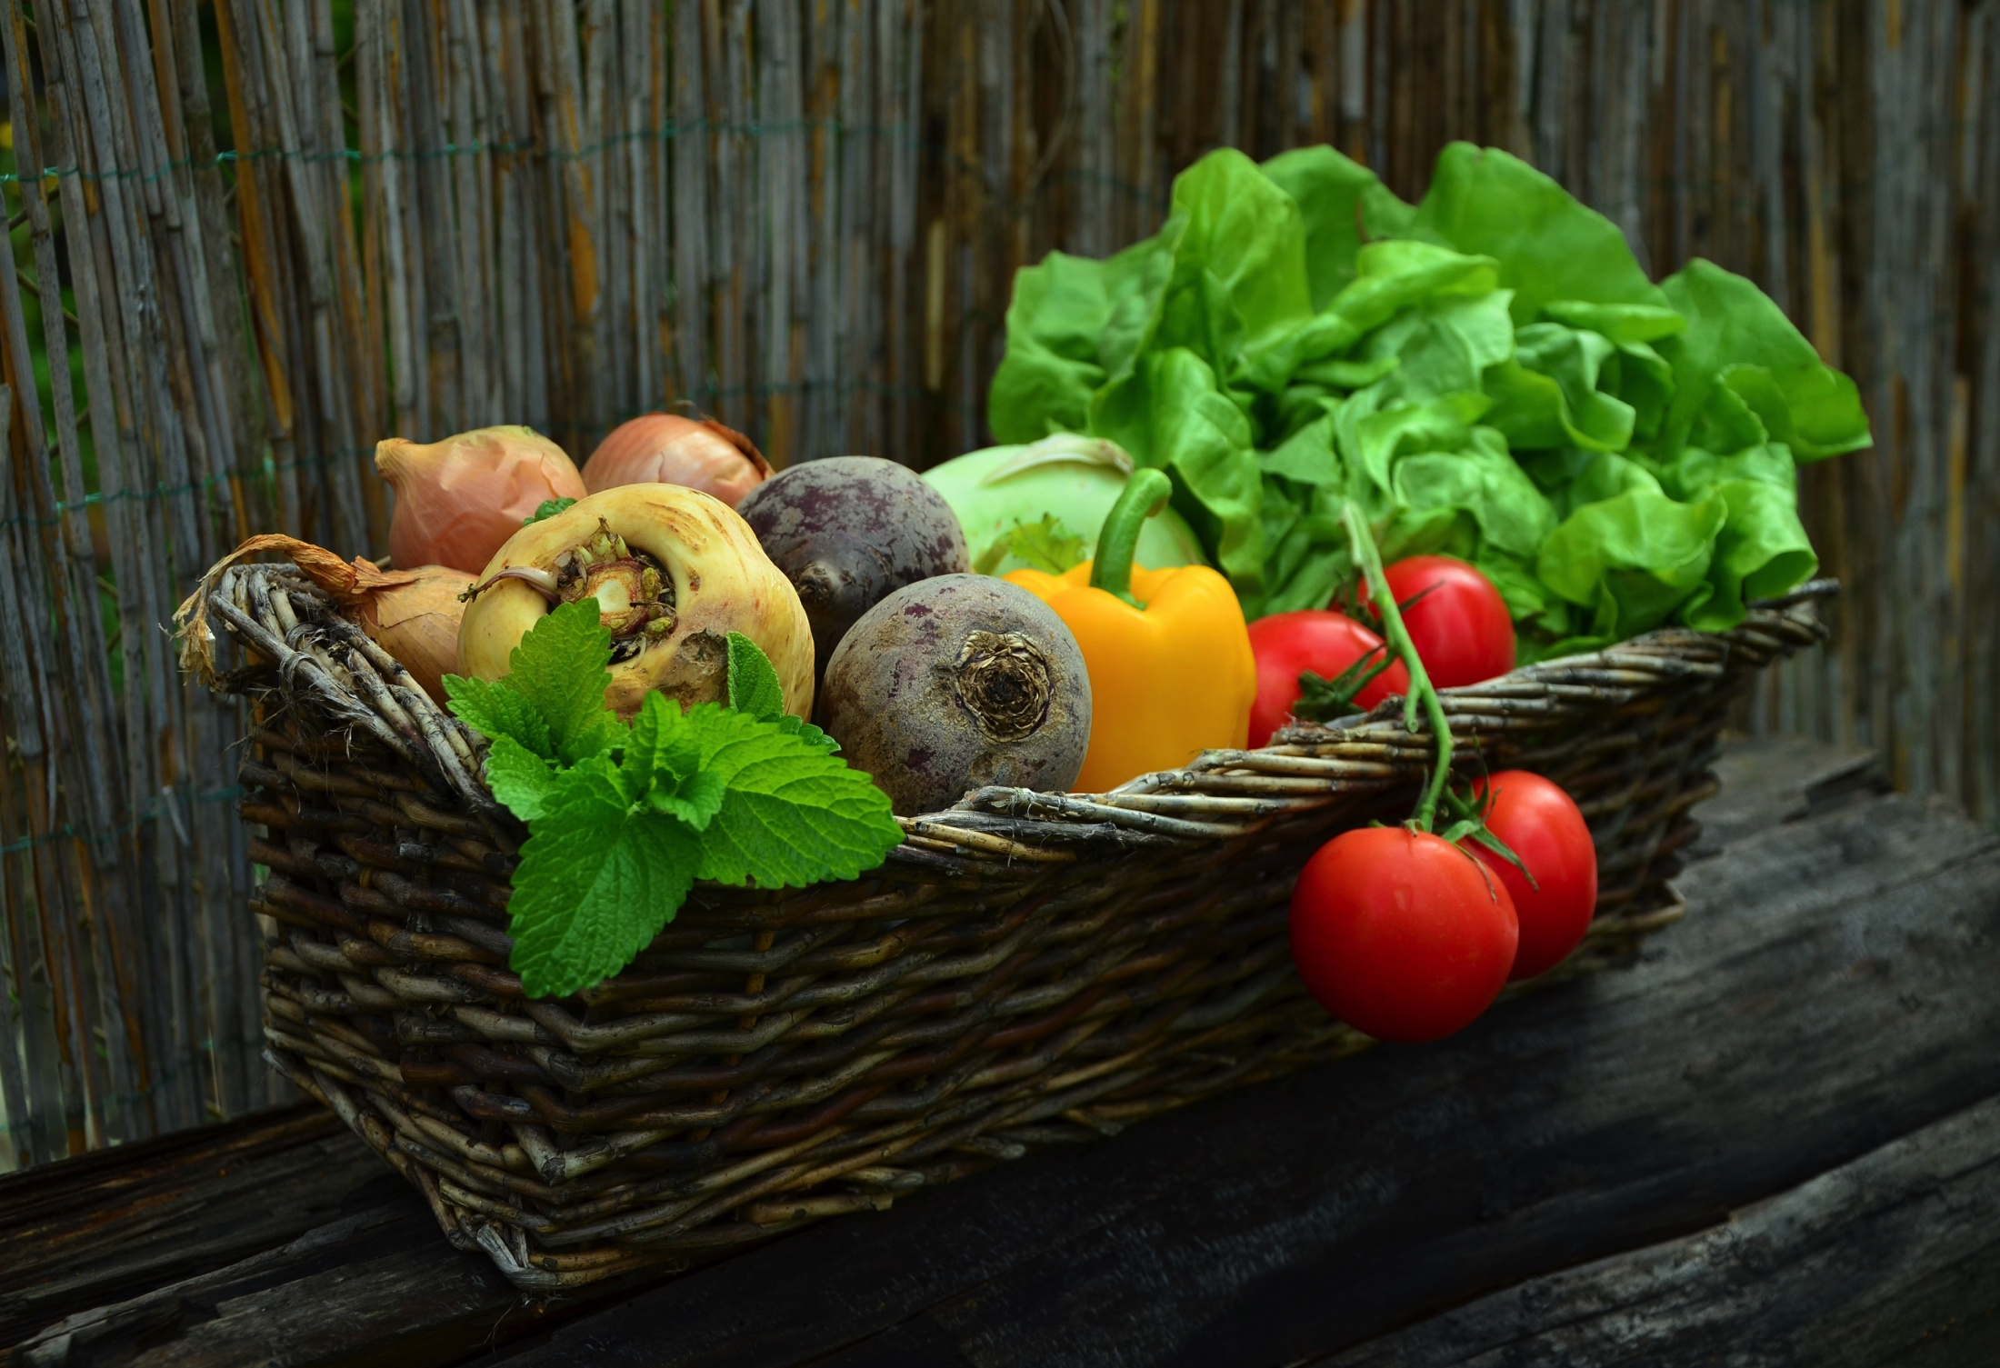
Containers & Packaging

Slide 15
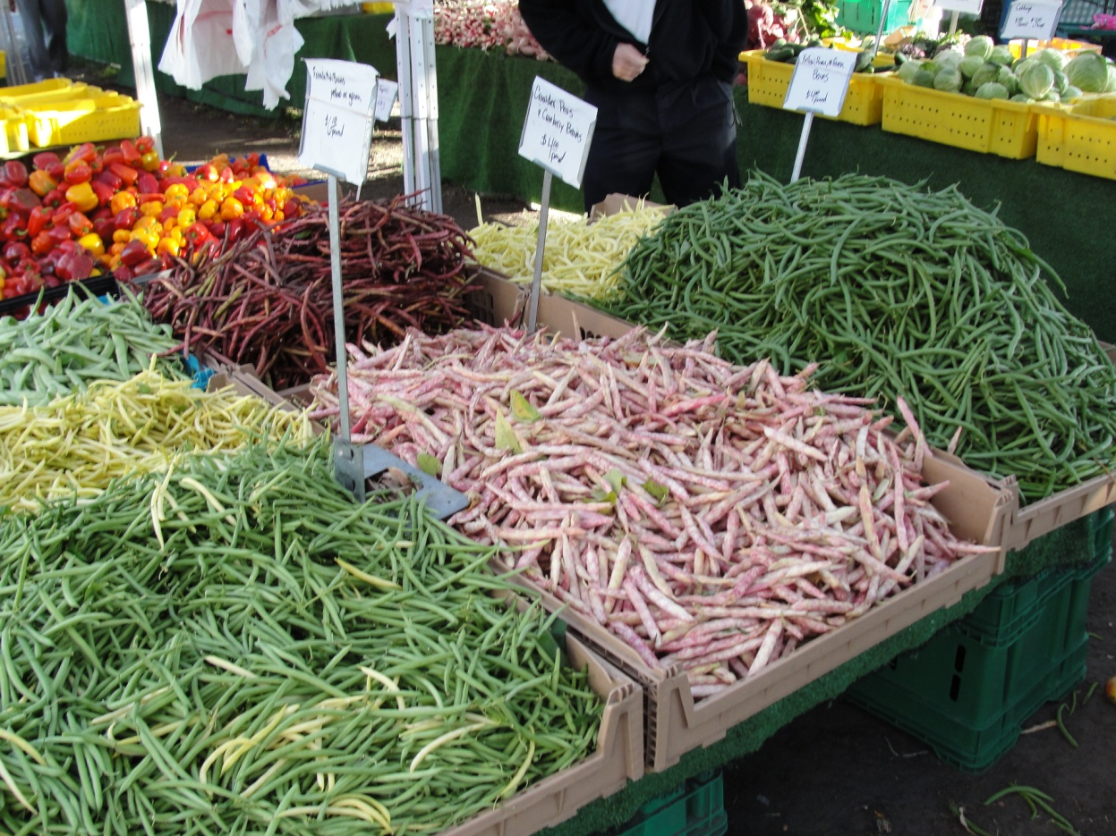
Random Weights Pricing
Less packaging cost
Need to keep full stock
Customer culling
Sanitary handling
Certified scales

Slide 16
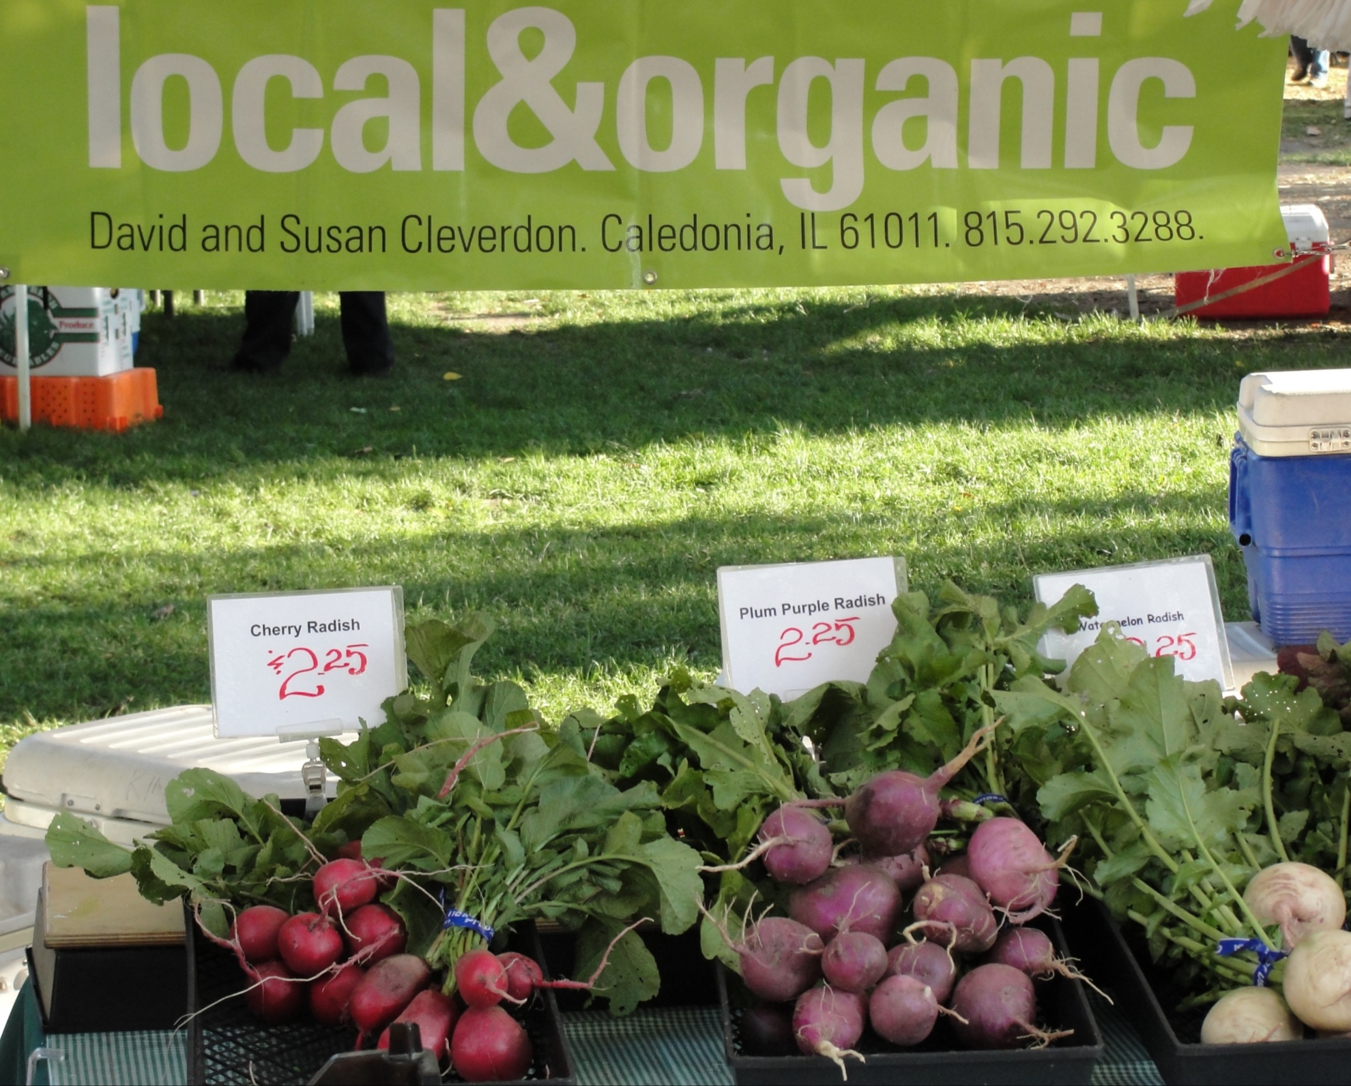

Slide 17
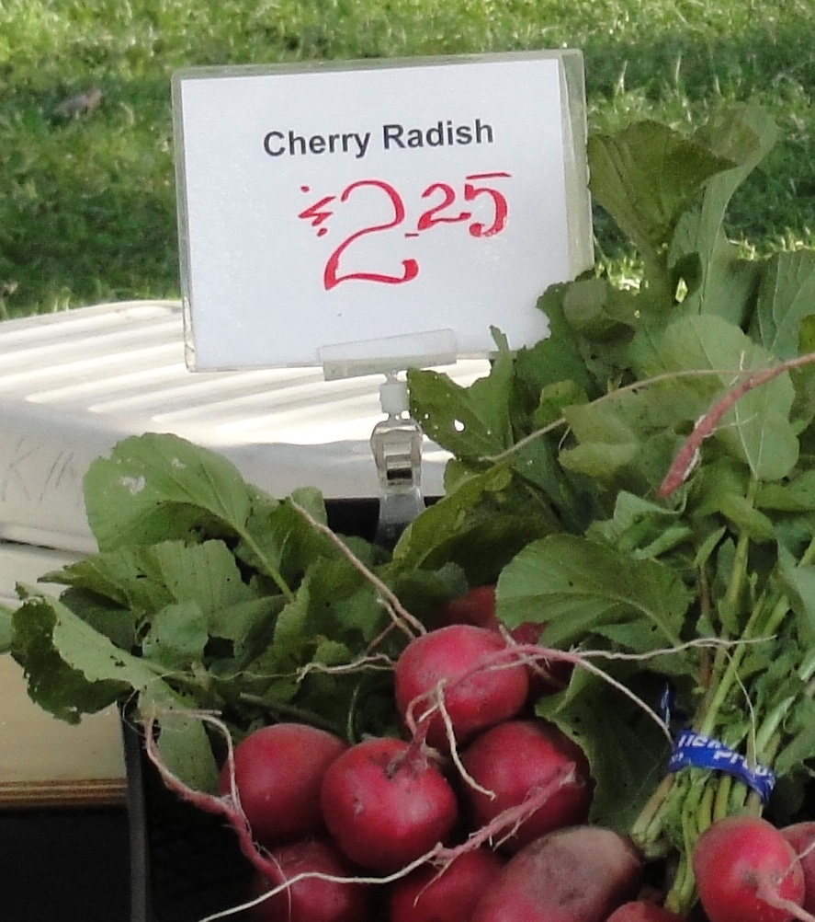

Slide 18
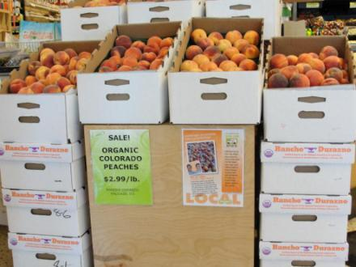
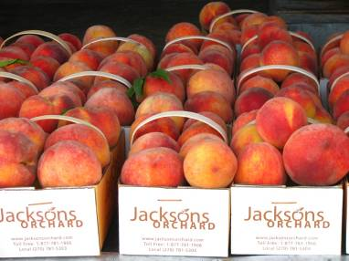
Generic vs Grower’s Peach Boxes

Slide 19
Time to Display
Your task:
Use the materials I have brought to assemble an attractive display. We have a wide variety of fruit and vegetable food models available.
Bring your sheet with you to help you think through the elements you want to include

Slide 20
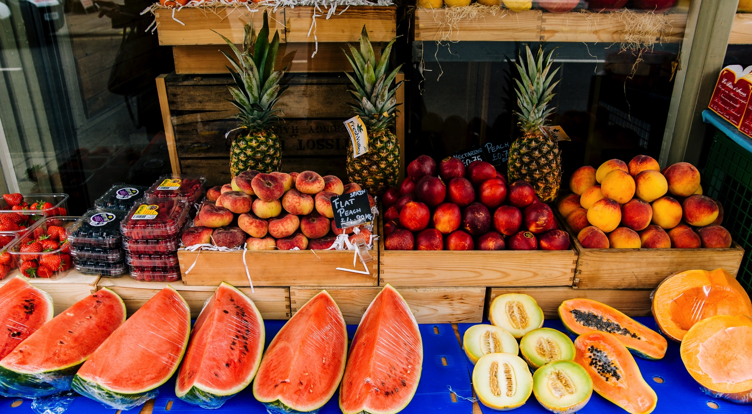
Sampling

Slide 21
Sampling & Demonstration Services in Perspective
Based on 302 patron intercepts in 11 different KY Farm Markets, Summer 2009
Services rated on 1 = ‘not important’ to 10 = ‘very important’

Slide 22
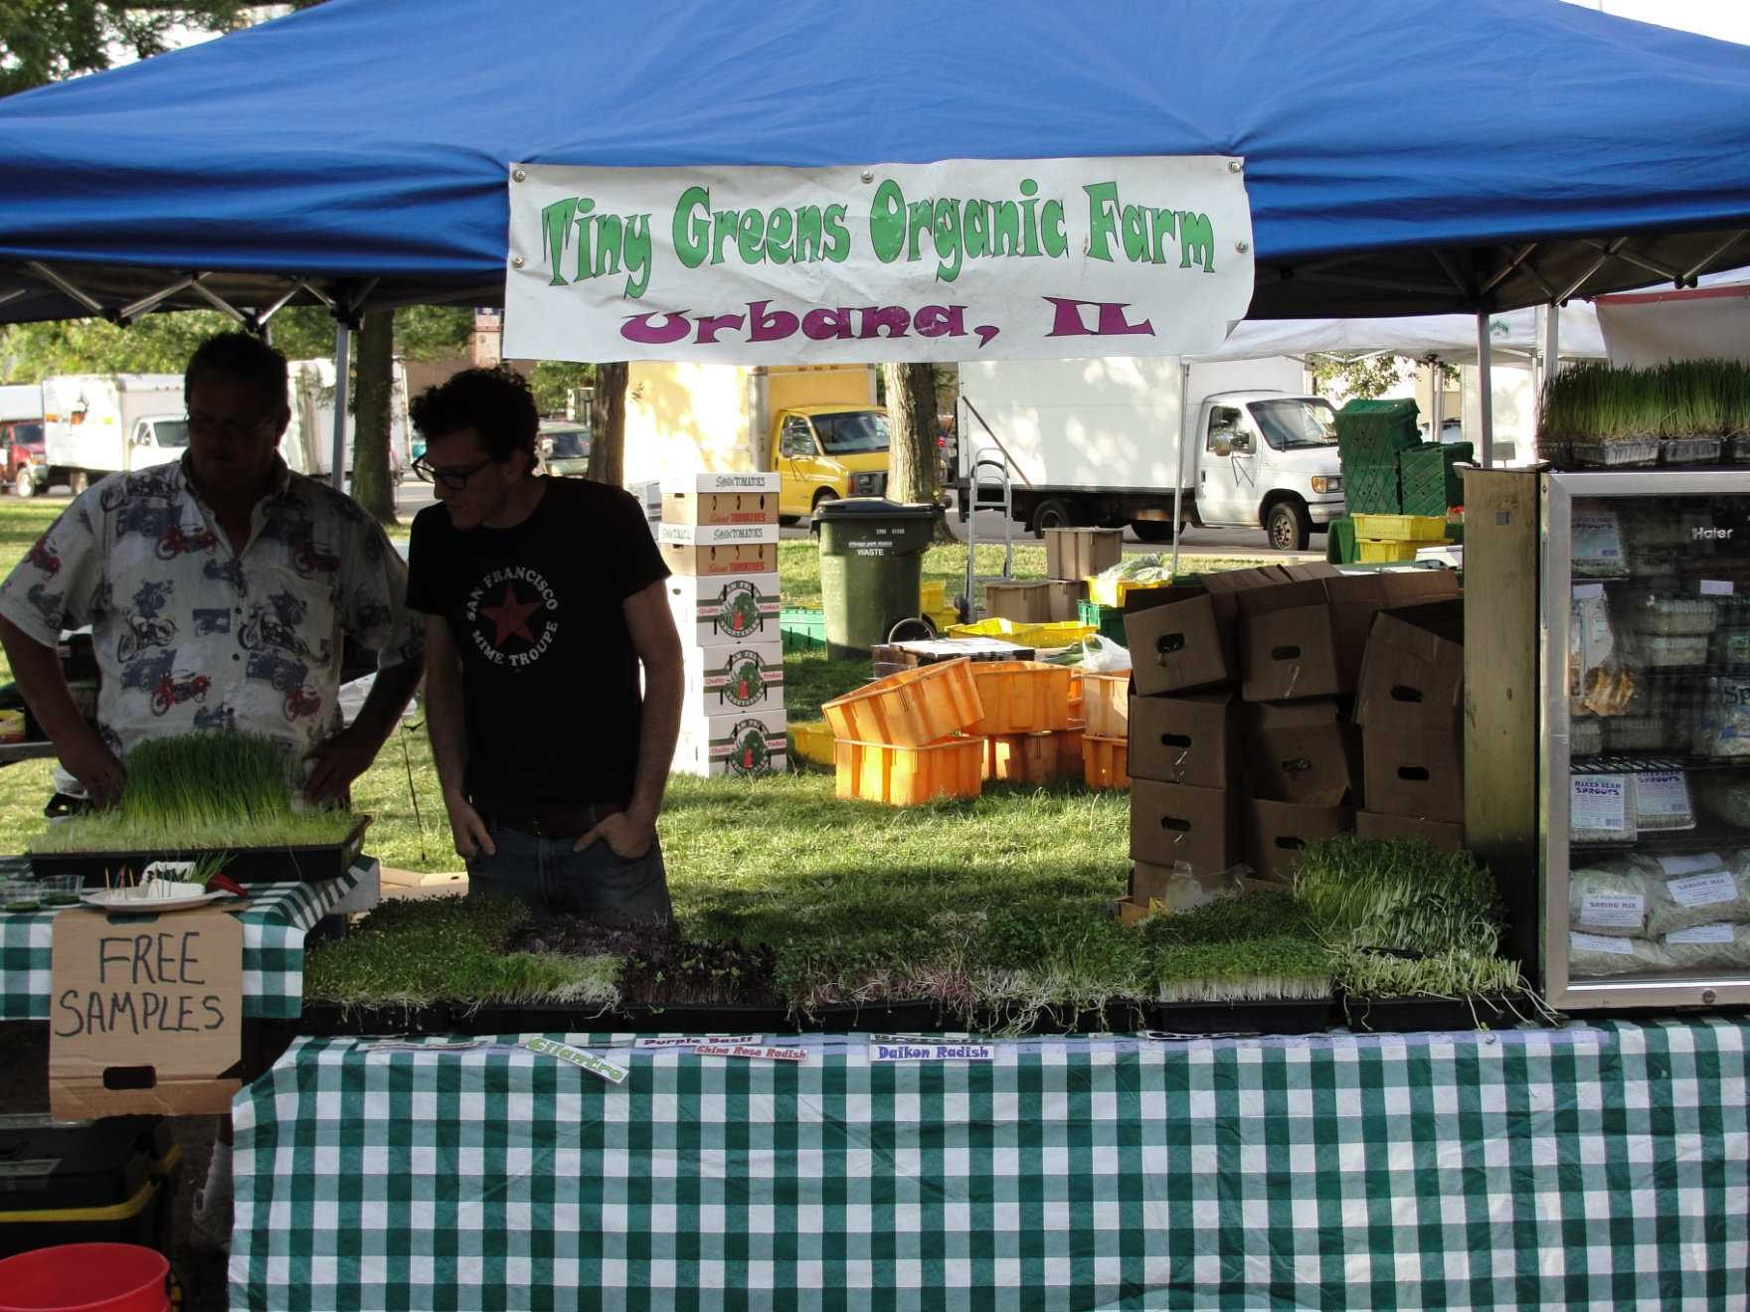

Slide 23
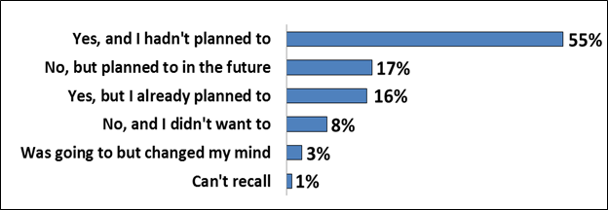
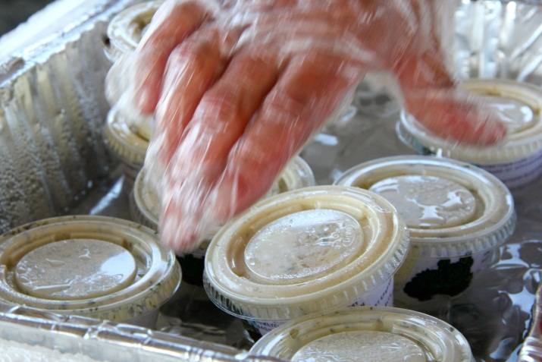
Frequency of Product Purchasing
N = 1,132

Slide 24

Best Practices Guide
Tips to get most out of sampling
Sampling strategies for small markets
Sampling tools check list
Best practices check list
  Preparation
  Delivery
  Follow-up
FAQs and resources

Slide 25


DATES (2 YEAR TERM) | TOTAL SAMPLING CERTIFICATES ISSUED | ALL SAMPLES | COOKED/ PROCESSED SAMPLES
2016-2017 | 1,236 | 1,033 | 203
2014-2015 | 1,130 | 908 | 221
2012-2013 | 909 | 696 | 213
2010-2011 | 742 | 545 | 197
Notes:
Lots of new programs and technical assistance helping expand vitality at farmers markets - - sampling, market price reporting, merchandising etc

Slide 26
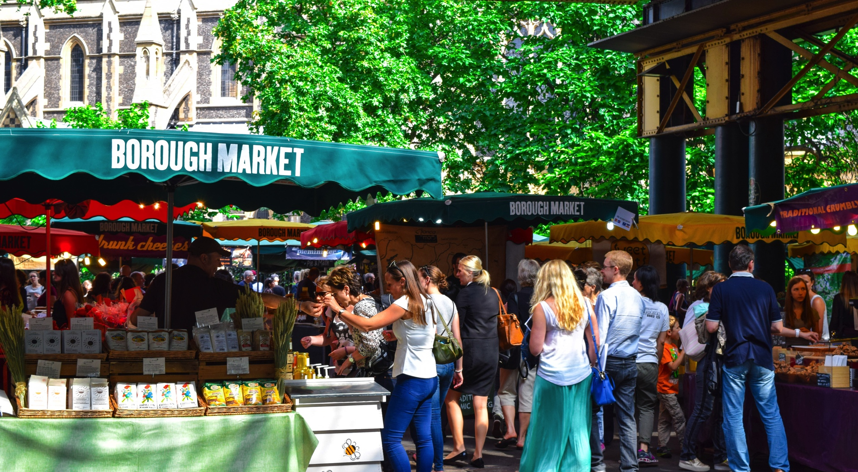
Record & Reflect

