Slide 1



Setting Prices for Retail Markets
Gabriel Cassone
Gabe.Cassone@uky.edu
Brett Wolff
brett.wolff@uky.edu

Slide 2
Are you charging enough?
What is the “going price?”
How much does it cost you?

Slide 3

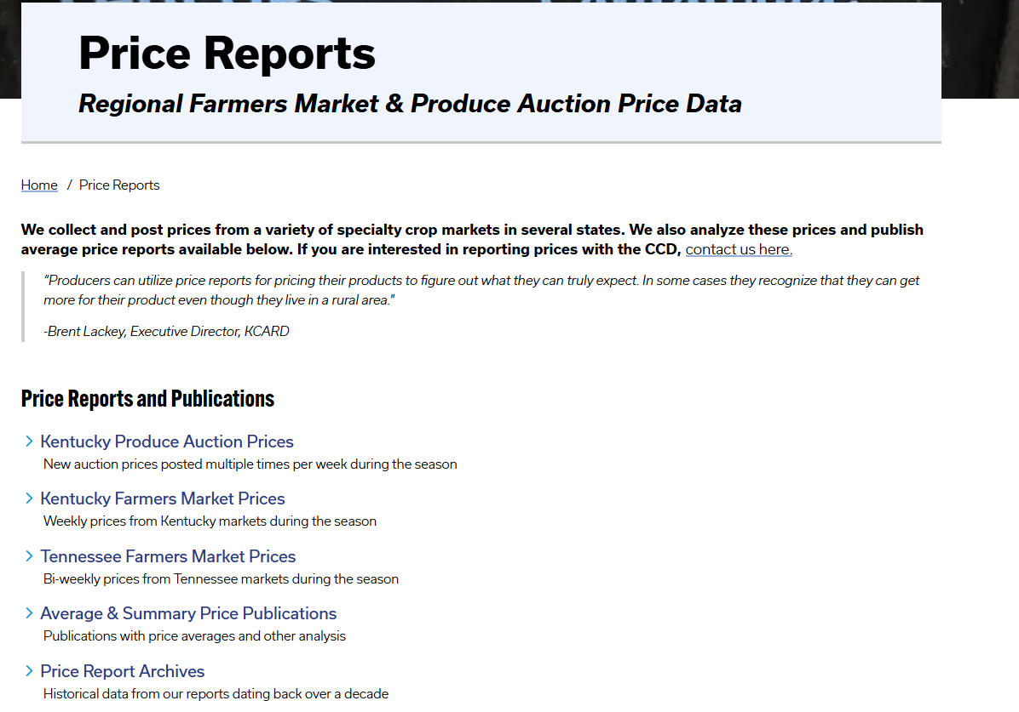

Slide 4
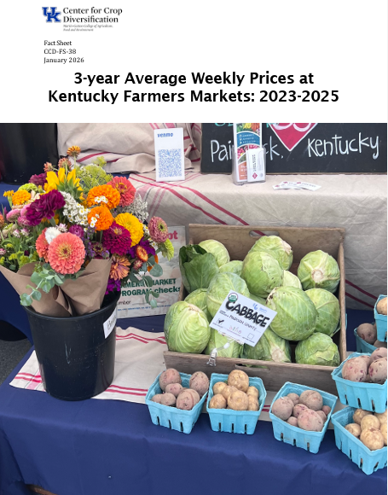
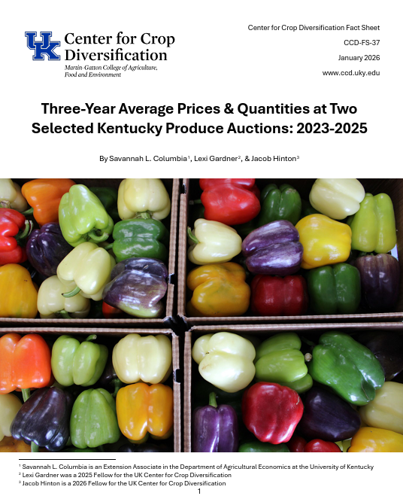

Slide 5


Slide 6
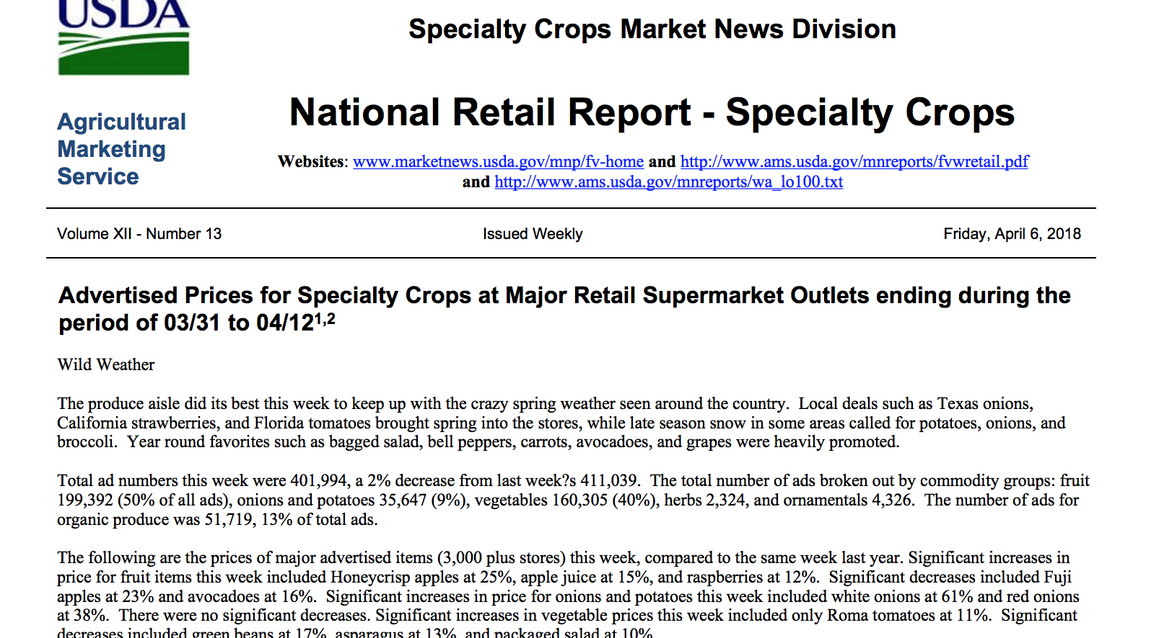

Slide 7
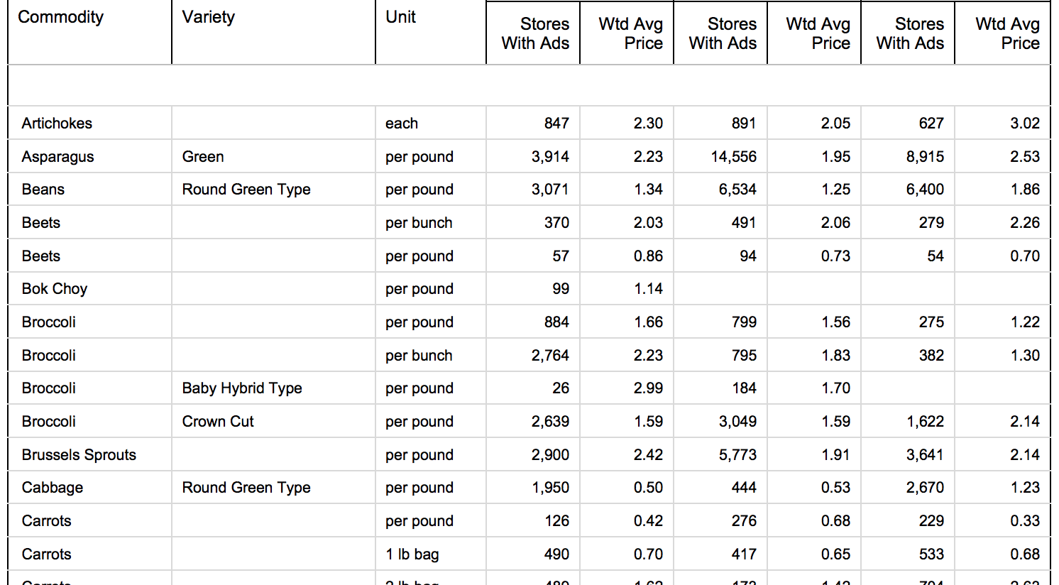

Slide 8
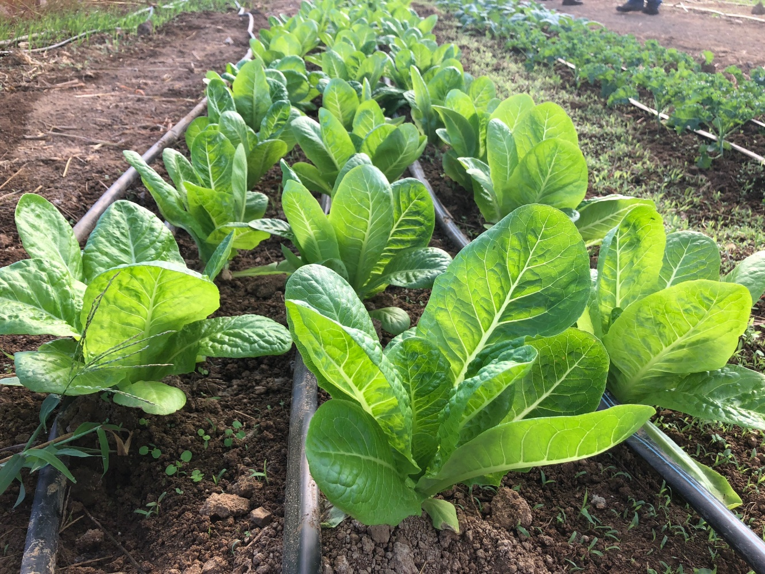
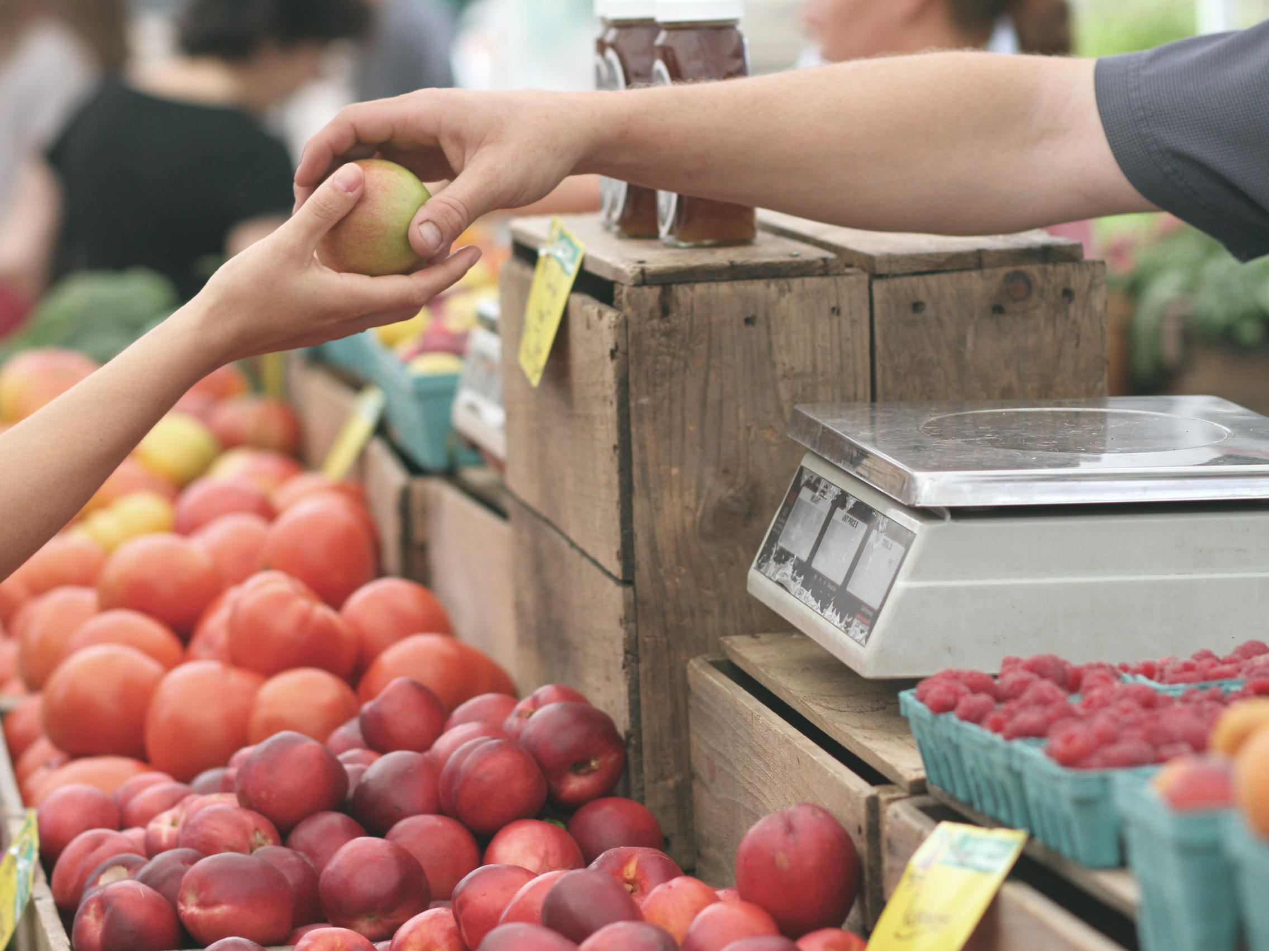
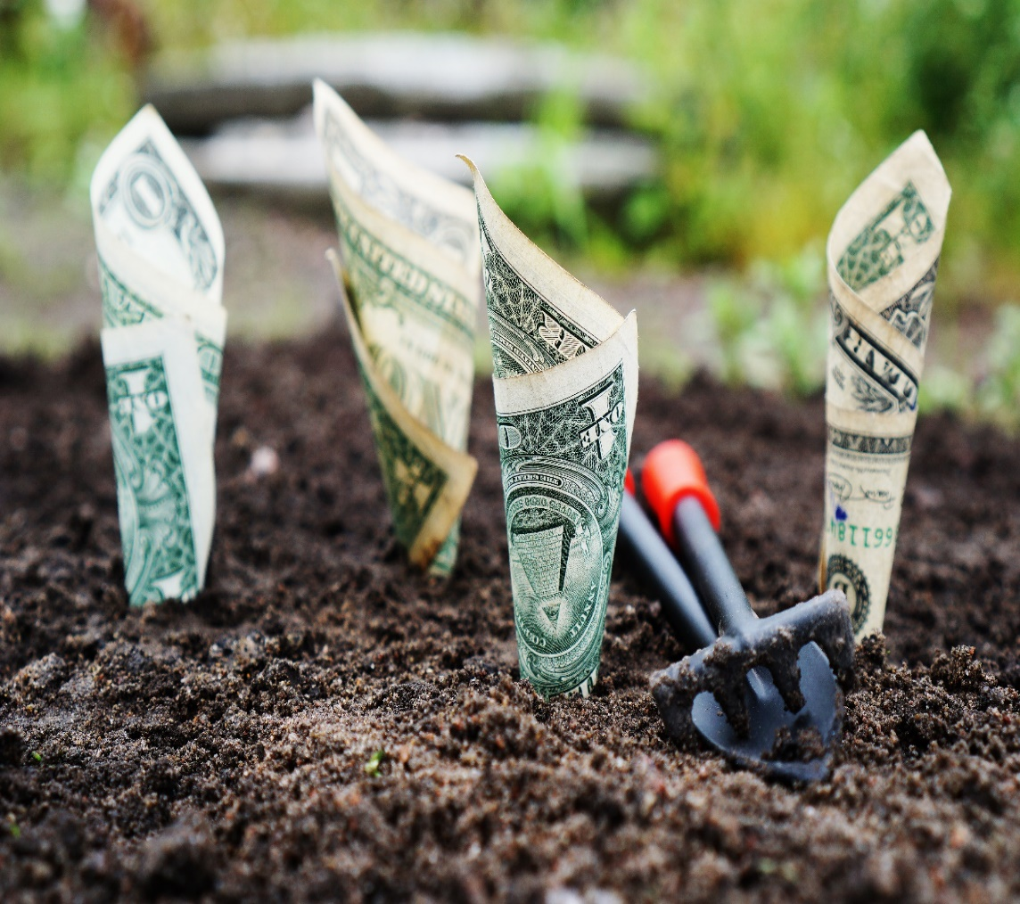

Product
Place
Price
Promotion

Slide 9
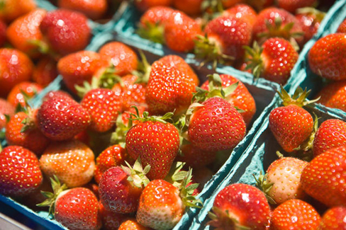
Product
Photo Credit: Matt Barton, UK AgComm
Notes:
What product are you selling? Are you selling anything else?
Customer Solution

Slide 10
Product
Locality
Relationship
Transparency
Quality
Notes:
There are other things you are selling your customers.
How important are these attributes to the people you sell to?
Quality is a multi-faceted variable relating to sizing, flavor, shelf-life, attractiveness, and lots of other things. This will vary by market channel.

Slide 11
Are you charging enough?
What is the “going price?”
How much does it cost you?

Slide 12
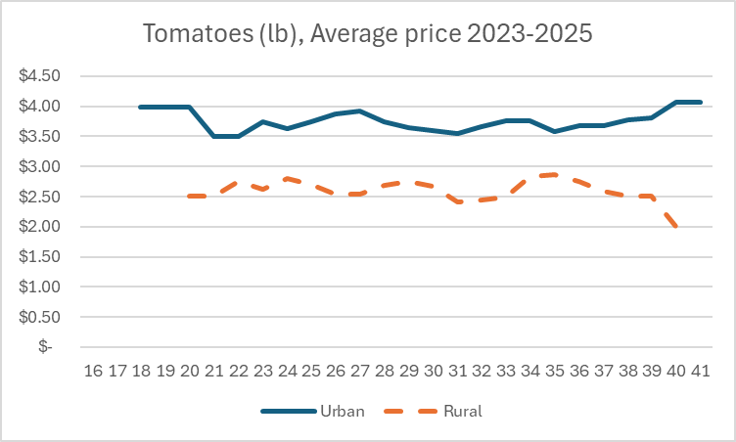
Place

Slide 13
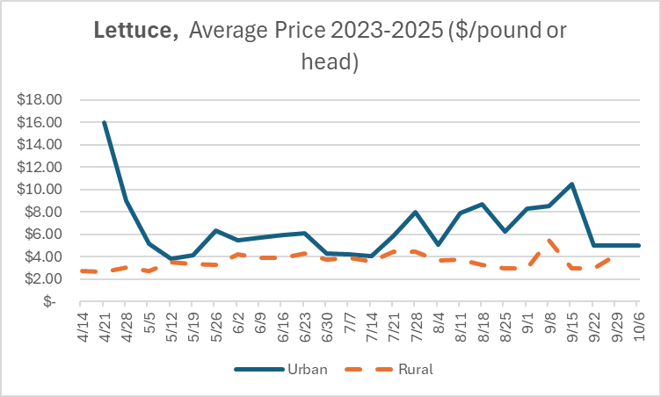

Slide 14
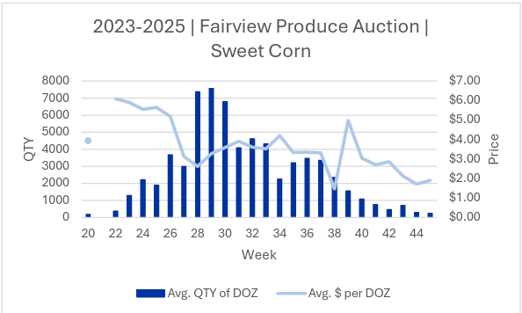
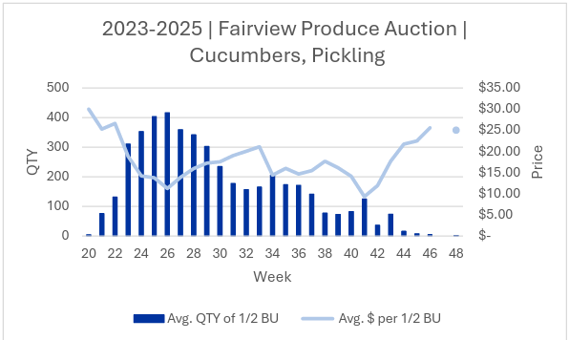
As quantity increases, price decreases
If sellers in your market look like you, distinguish yourself or move
Graphs: Savannah Columbia 2023-2025 Average Produce Auction report

Slide 15
Average Crop Price Changes: 2023 vs. 2024 vs. 2025
Market Type | % Change 23-24 (1 Year) | % Change 24-25 (1 Year)
All Markets | +7% | +9%
Urban | +2% | +15%
Rural | +7% | +7%

Slide 16
Are you charging enough?
What is the “going price?”
How much does it cost you?

Slide 17
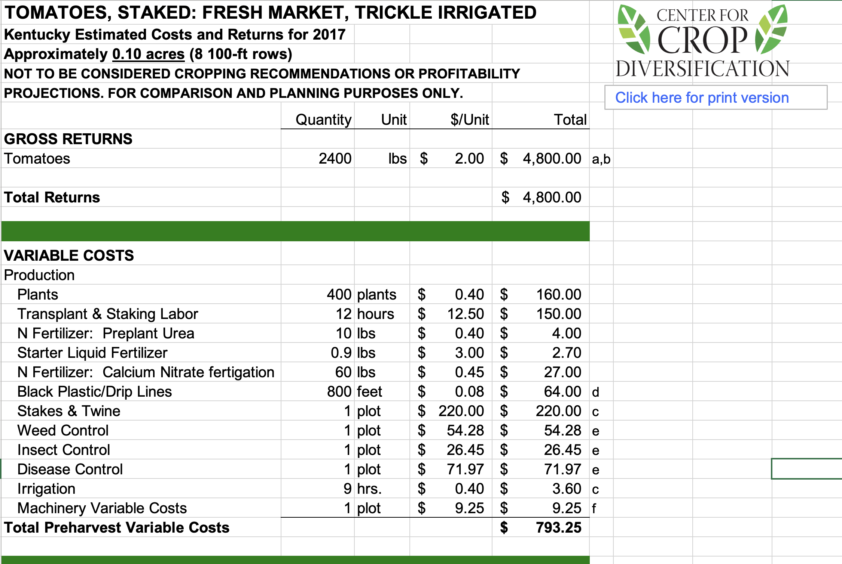
CCD Enterprise Budgets
Prefilled with ballpark example expenses, but fully editable so you can use your own projected costs.
The next slides are JUST EXAMPLES!!!

Slide 18
Component | Description | Total Cost
Inputs | $10.00 (fertilizer, pesticide, water) | $10.00
Plants | 50 @ $1.25 / ea | $62.50
Stakes | 10 @ $.50 / ea | $5.00
Labor (Prep, Planting, Pruning, Harvest, Cleanup) | 30 hours @ $10.00 /hr | $300.00
Labor staffing booth | 8 hrs x 10 weekends x $10 / hr | $800.00
Vehicle Costs | 10 mi round trip x 10 trips x $.50 / mi | $50.00
Total Rough Costs | **Booth Fee** | $1227.50

Slide 19
Yield/Plant | # plants | Total Yield | Total Yield / 10 weeks
15 lb | 50 | 750 | 75 lbs
20 lb | 50 | 1000 | 100 lbs
25 lb | 50 | 1250 | 125 lbs

Slide 20
Average weekly Sales | Price / lb | Revenue / week | Total Revenue 10 weeks
100 lbs | $1.25 | $125 | $1250.00
75 lbs | $1.25 | 93.75 | $937.50
50 lbs | $1.25 | 62.50 | $625.00
30 lbs | $1.25 | 37.50 | $375.00

Slide 21
Component | Description | Total Cost
Inputs | $10.00 (fertilizer, pesticide, water) | $10.00
Plants | 50 @ $1.25 / ea | $62.50
Stakes | 10 @ $.50 / ea | $5.00
Labor (Prep, Planting, Pruning, Harvest, Cleanup) | 30 hours @ $10.00 /hr | $300.00
Labor staffing booth | 8 hrs x 10 weekends x $10 / hr | $800.00
Vehicle Costs | 10 mi round trip x 10 trips x $.50 / mi | $50.00
Total Rough Costs |  | $1227.50

Slide 22
Average weekly Sales | Price / lb | Revenue / week | Total Revenue 10 weeks
100 lbs | $2.00 | $200.00 | $2000.00
75 lbs | $2.00 | $150.00 | $1500.00
50 lbs | $2.00 | $100.00 | $1000.00
30 lbs | $2.00 | $60.00 | $600.00

Slide 23
Average weekly Sales | Price / lb | Revenue / week | Total Revenue 10 weeks
100 lbs | $2.50 | $250 | $2500.00
75 lbs | $2.50 | 187.50 | $1875.00
50 lbs | $2.50 | 125.00 | $1250.00
30 lbs | $2.50 | 75.00 | $750.00

Slide 24
Average weekly Sales | 10 Week Profit @1.25 /lb | 10 Week Profit @2.00 /lb | 10 Week Profit @2.50 /lb
100 lbs | $22.50 | $772.50 | $1272.50
75 lbs | -$290.00 | $272.50 | $647.50
50 lbs | -$602.50 | -$227.50 | $22.50
30 lbs | -$852.50 | -$627.50 | -$477.50

Slide 25
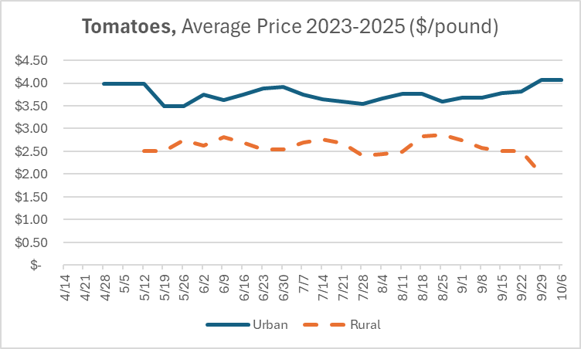
Most Rural Markets charged over $2.50 per pound for tomatoes in 2025.
Most Urban markets had vendors charging $3.50+ in 2025
This is why pairing these cost considerations with an understanding of the "going price" is so important.
It's not crazy to ask $3/lb for tomatoes!

Slide 26
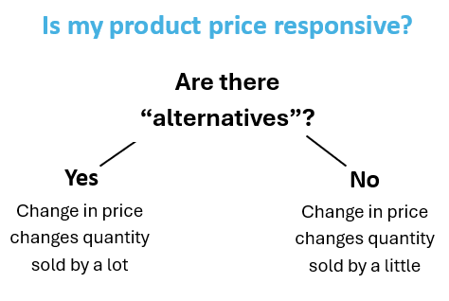
Barriers to higher prices
Price Elasticity
If price increases, how many fewer will I sell?
If price decreases, how many more will I sell?
Neighbor Jims organic Pawpaws
VS
Grocery white Rice

Slide 27
Examples
Example 1: $2.50 per pound x 100 pounds sold= $250 profit
Price Responsive: $3.00 per pound x 80 pounds sold = $240 revenue
Not Price Responsive: $3.00 per pound x 95 pounds sold = $285 revenue
Example 2: $3.00 per pound x 100 pounds sold = $300 profit
Price Responsive: $2.50 per pound x 140 pounds sold = $350 revenue
Not Price Responsive: $2.50 per pound x 110 pounds sold = $275 revenue

Slide 28
Barriers to higher prices
“This is the price we have always charged.”

Slide 29
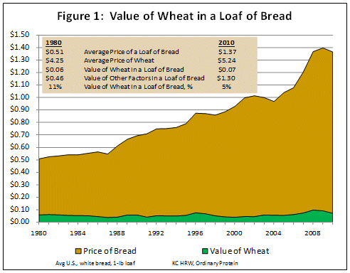
Jose Peña, Texas A&M University, 2010

Slide 30
Pricing Strategies
Premium Pricing
Bundling
Bulk Pricing
Loss Leader

Slide 31
Setting Prices for Retail Markets
Gabriel Cassone
Gabe.Cassone@uky.edu
Brett Wolff
brett.wolff@uky.edu

