Slide 1
Accepting More Than Just Cash
Savannah Columbia, Extension Associate
Notes:
Hi everyone, thanks for having me today! My name is Savannah Columbia, and I am an extension associate in the University’s ag econ department and I am a part of UK’s center for crop diversification. I just want to put another plug in that presentations like these are made possible by our Specialty Crop Block Grant funding. So, let’s dig in.

Slide 2
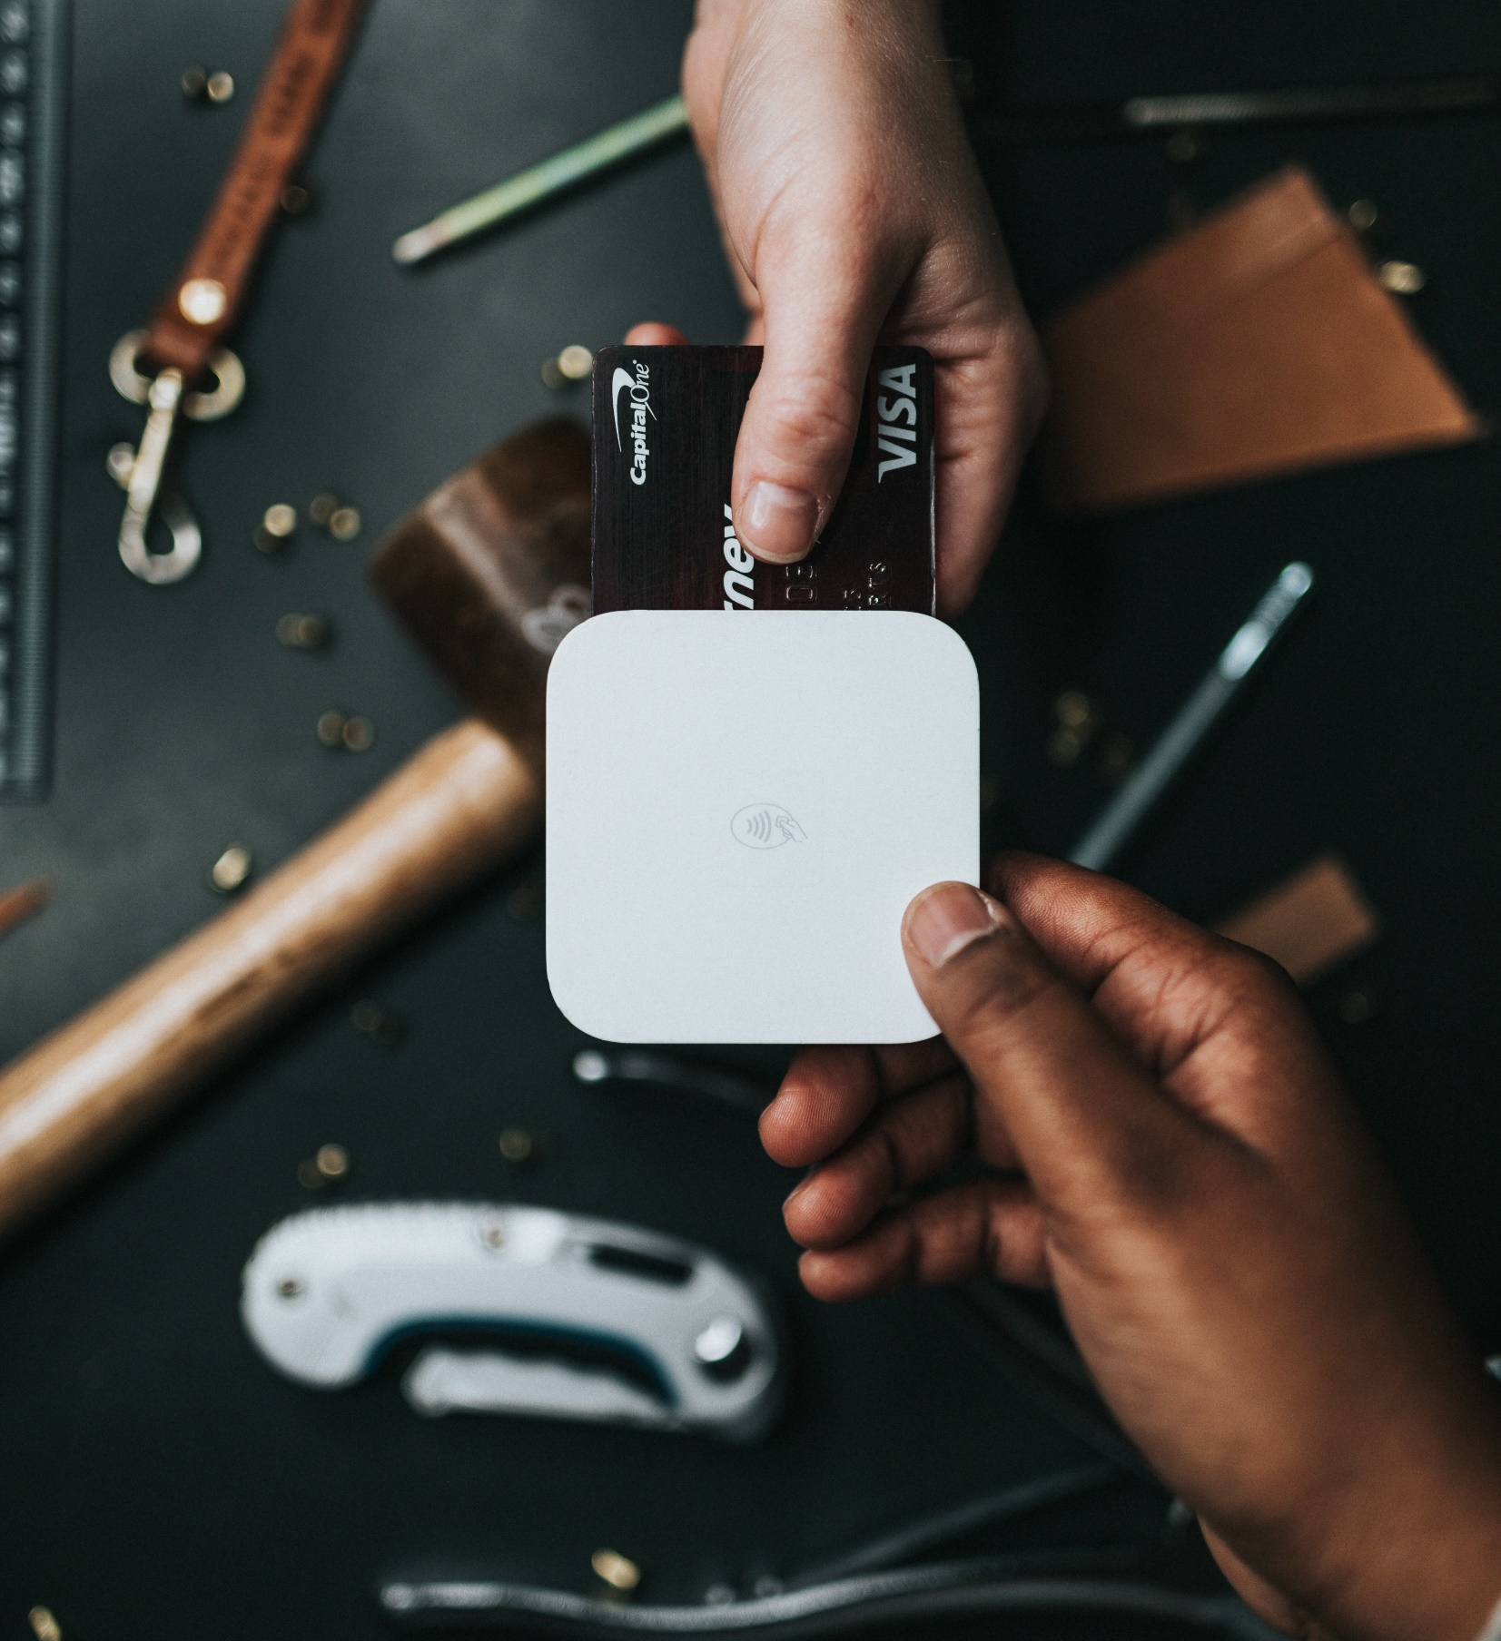
Today’s Objective
To learn about various methods of payment
To learn why it could be helpful to accept more than just cash
Notes:
The goal for today is to provide you with information about various methods of payment you may want to accept from consumers in your marketing channel. And with each of these payment methods, we will talk about why it can be beneficial for you to accept them, if you don’t already – which is cleverly where we get the title: accepting more than just cash.

Slide 3
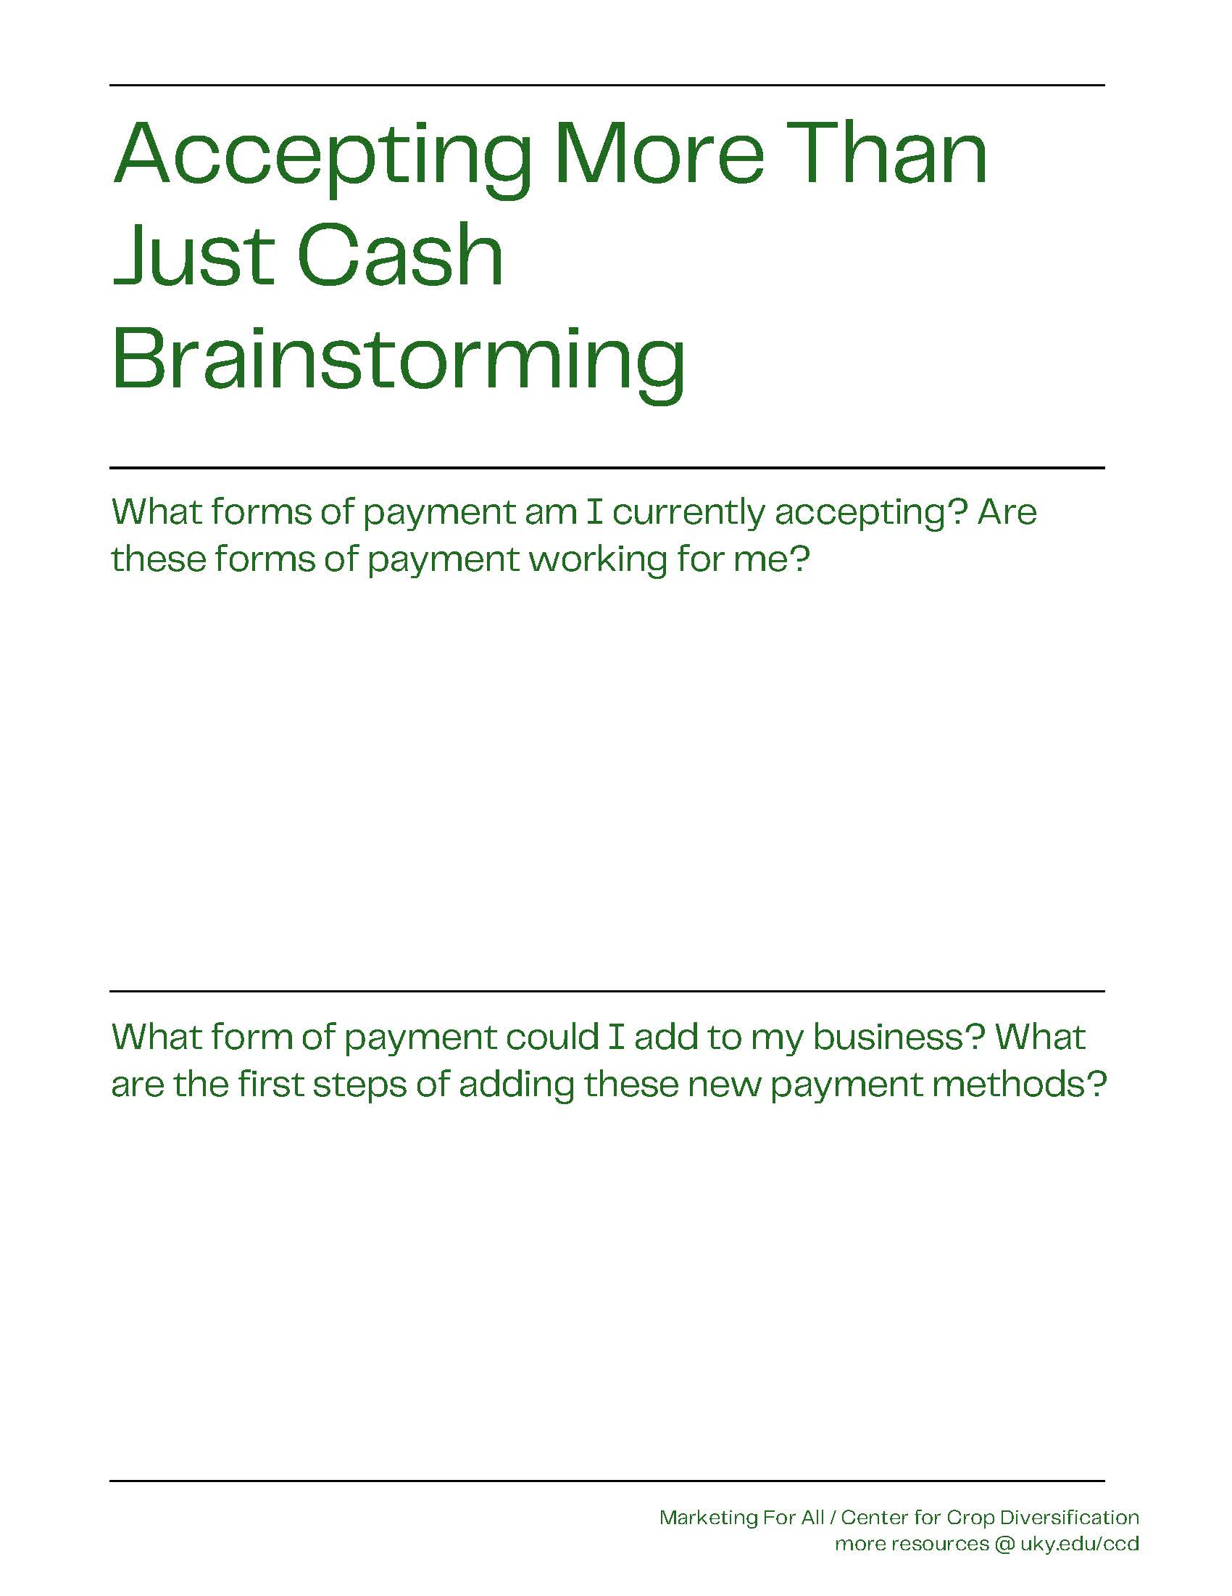
To get us thinking…
What types of payment do you accept?
Are these working for you?
Notes:
So just to get us thinking and preface this conversation, I want to start with two questions. These questions just get us thinking a bit about where we are as producers in our marketing channels and what we like or don’t like about the various payment methods. So, what types of payment do you accept? Cash and cards? Just cash? Only cards through a card reader?
Let’s fill out the first part of our brainstorming worksheet. This helps us preface what we accept as payment before exploring what we could accept as payment. So, let’s ponder on this for a few more seconds and then move forward.

Slide 4
Popular Forms of Payment
Cash
Credit & Debit Cards
  PayPal, Venmo, Google & Apple Pay, etc.
EBT/SNAP Benefits
Gift Cards
Notes:
Alright, so the popular forms of payment. I think at least a few of these payment methods will be somewhat familiar to each of you. As you may assume, cash and credit or debit cards are common forms of payment methods – followed by EBT/Snap benefits, gift cards, and other e-commerce sites. We will go though each of these together this evening so feel free to ask questions as we go or we can take questions at the end.

Slide 5
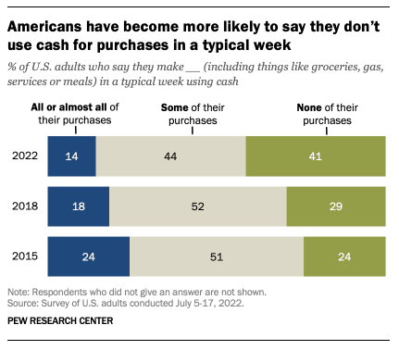
The Cold, Hard Cash Truth
Cash is easy to track & exchange. It doesn’t require additional technology or equipment
Cash use is on the decline
Only 14% of consumers always carry cash
Younger adults are least likely to have cash
Notes:
First, we will talk about cash. The great thing about cash is that it is pretty easy for sellers to track and exchange back and forth with customers. You aren’t obligated to any additional technology or service fees. However, cash use is on the decline. A lot of people are refraining from carrying cash anymore. Statistics say about 16% of consumers carry cash on them – that’s less than a quarter of consumers. On top of that – younger adults are even less likely to carry cash. So if you are only accepting cash as a payment method, you could be missing out on potential customers.

Slide 6
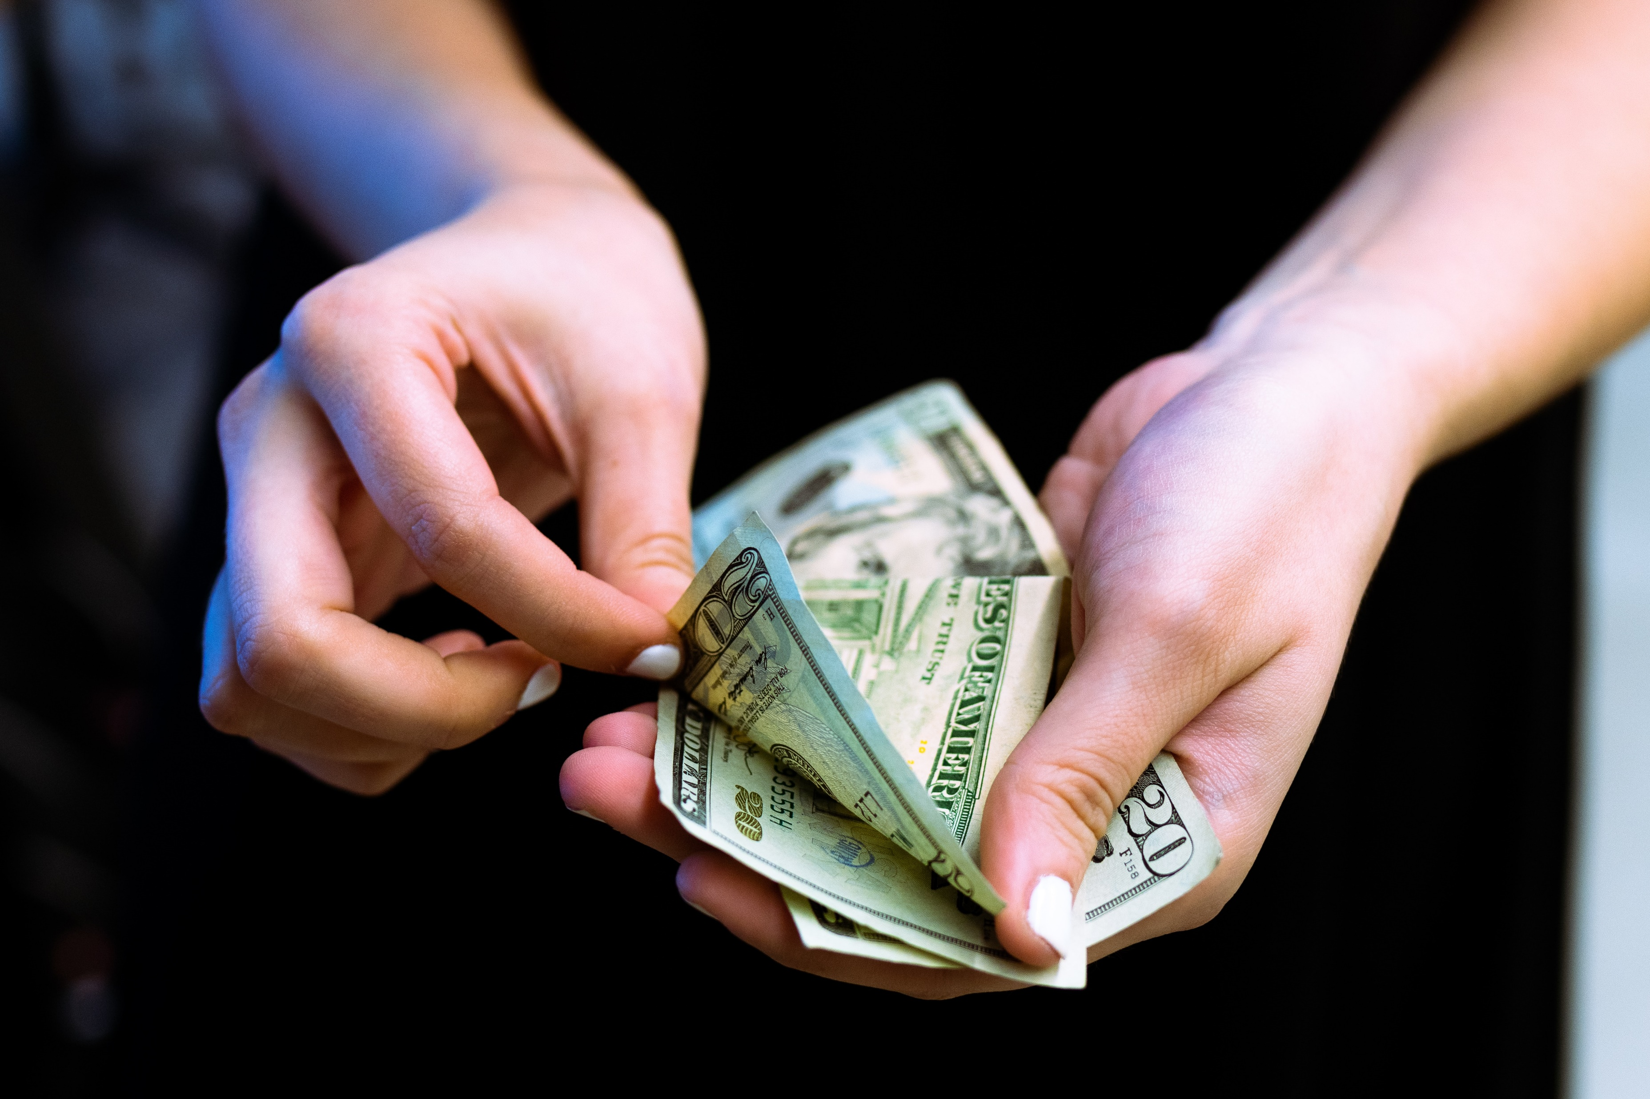
The Cold, Hard Cash Truth
While cash is still acceptable, technology has made it easier to avoid carrying cash
It is easy and convenient to “swipe”
Notes:
Like we talked about on our last slide, cash use is on the decline. Mostly because technology has made it easier for people to avoid carrying cash and change around with them. It is easy for us to swipe our little cards than to carry exact change in our pockets. Not to say that cash is not still an acceptable form of payment, but be sure to think about the ways to capture all of your potential customers.

Slide 7
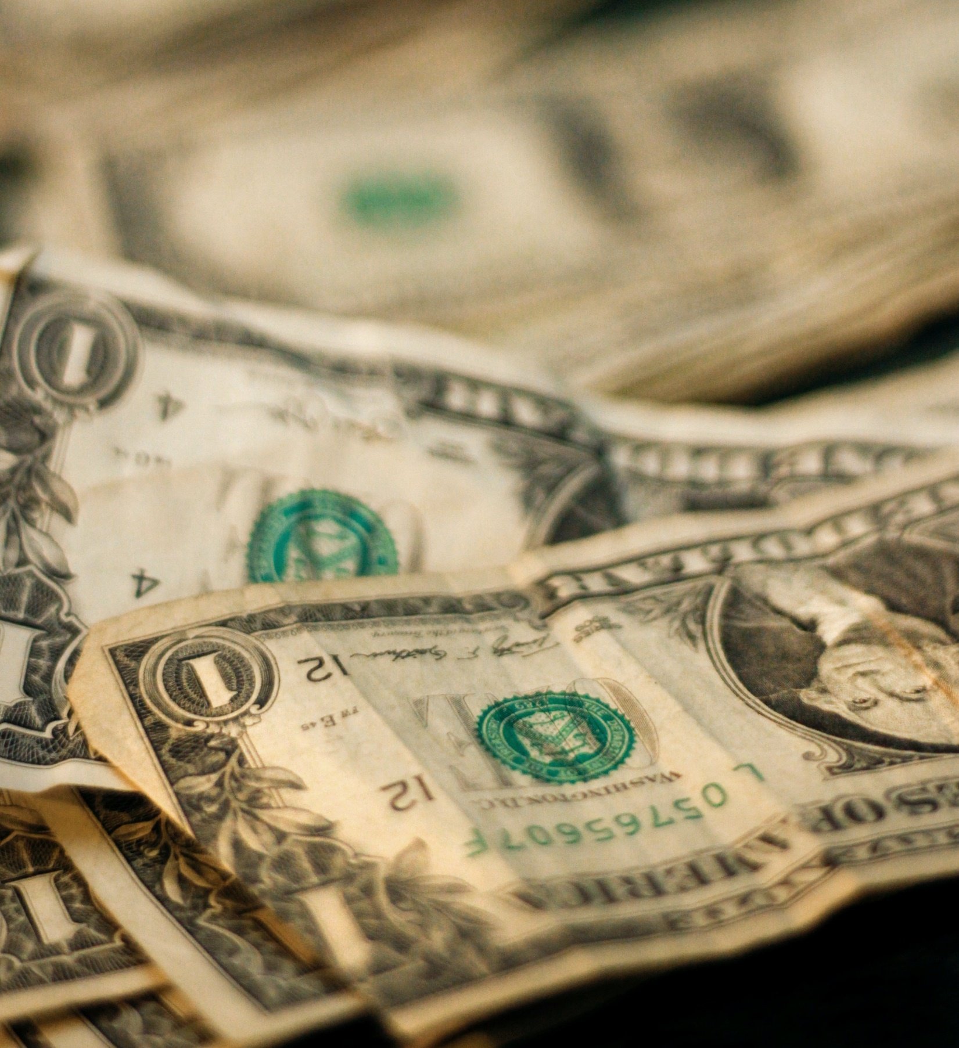
Cash: To Do or Not To Do?
Accepting cash reaches non-card-carrying consumers
Accepting more than just cash reaches consumers of other payment types
Notes:
So to do or not to do? Like I said, cash is still a perfectly okay form of payment. We don’t want to alienate our cash-carrying customers. They are often loyal and come to the market with your product in mind. But we also want to think about accepting more than just cash so we can reach consumers of other payment types.

Slide 8
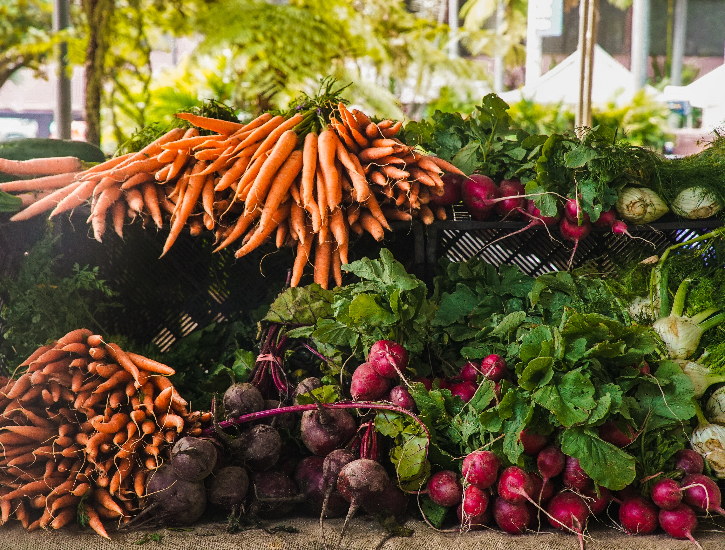
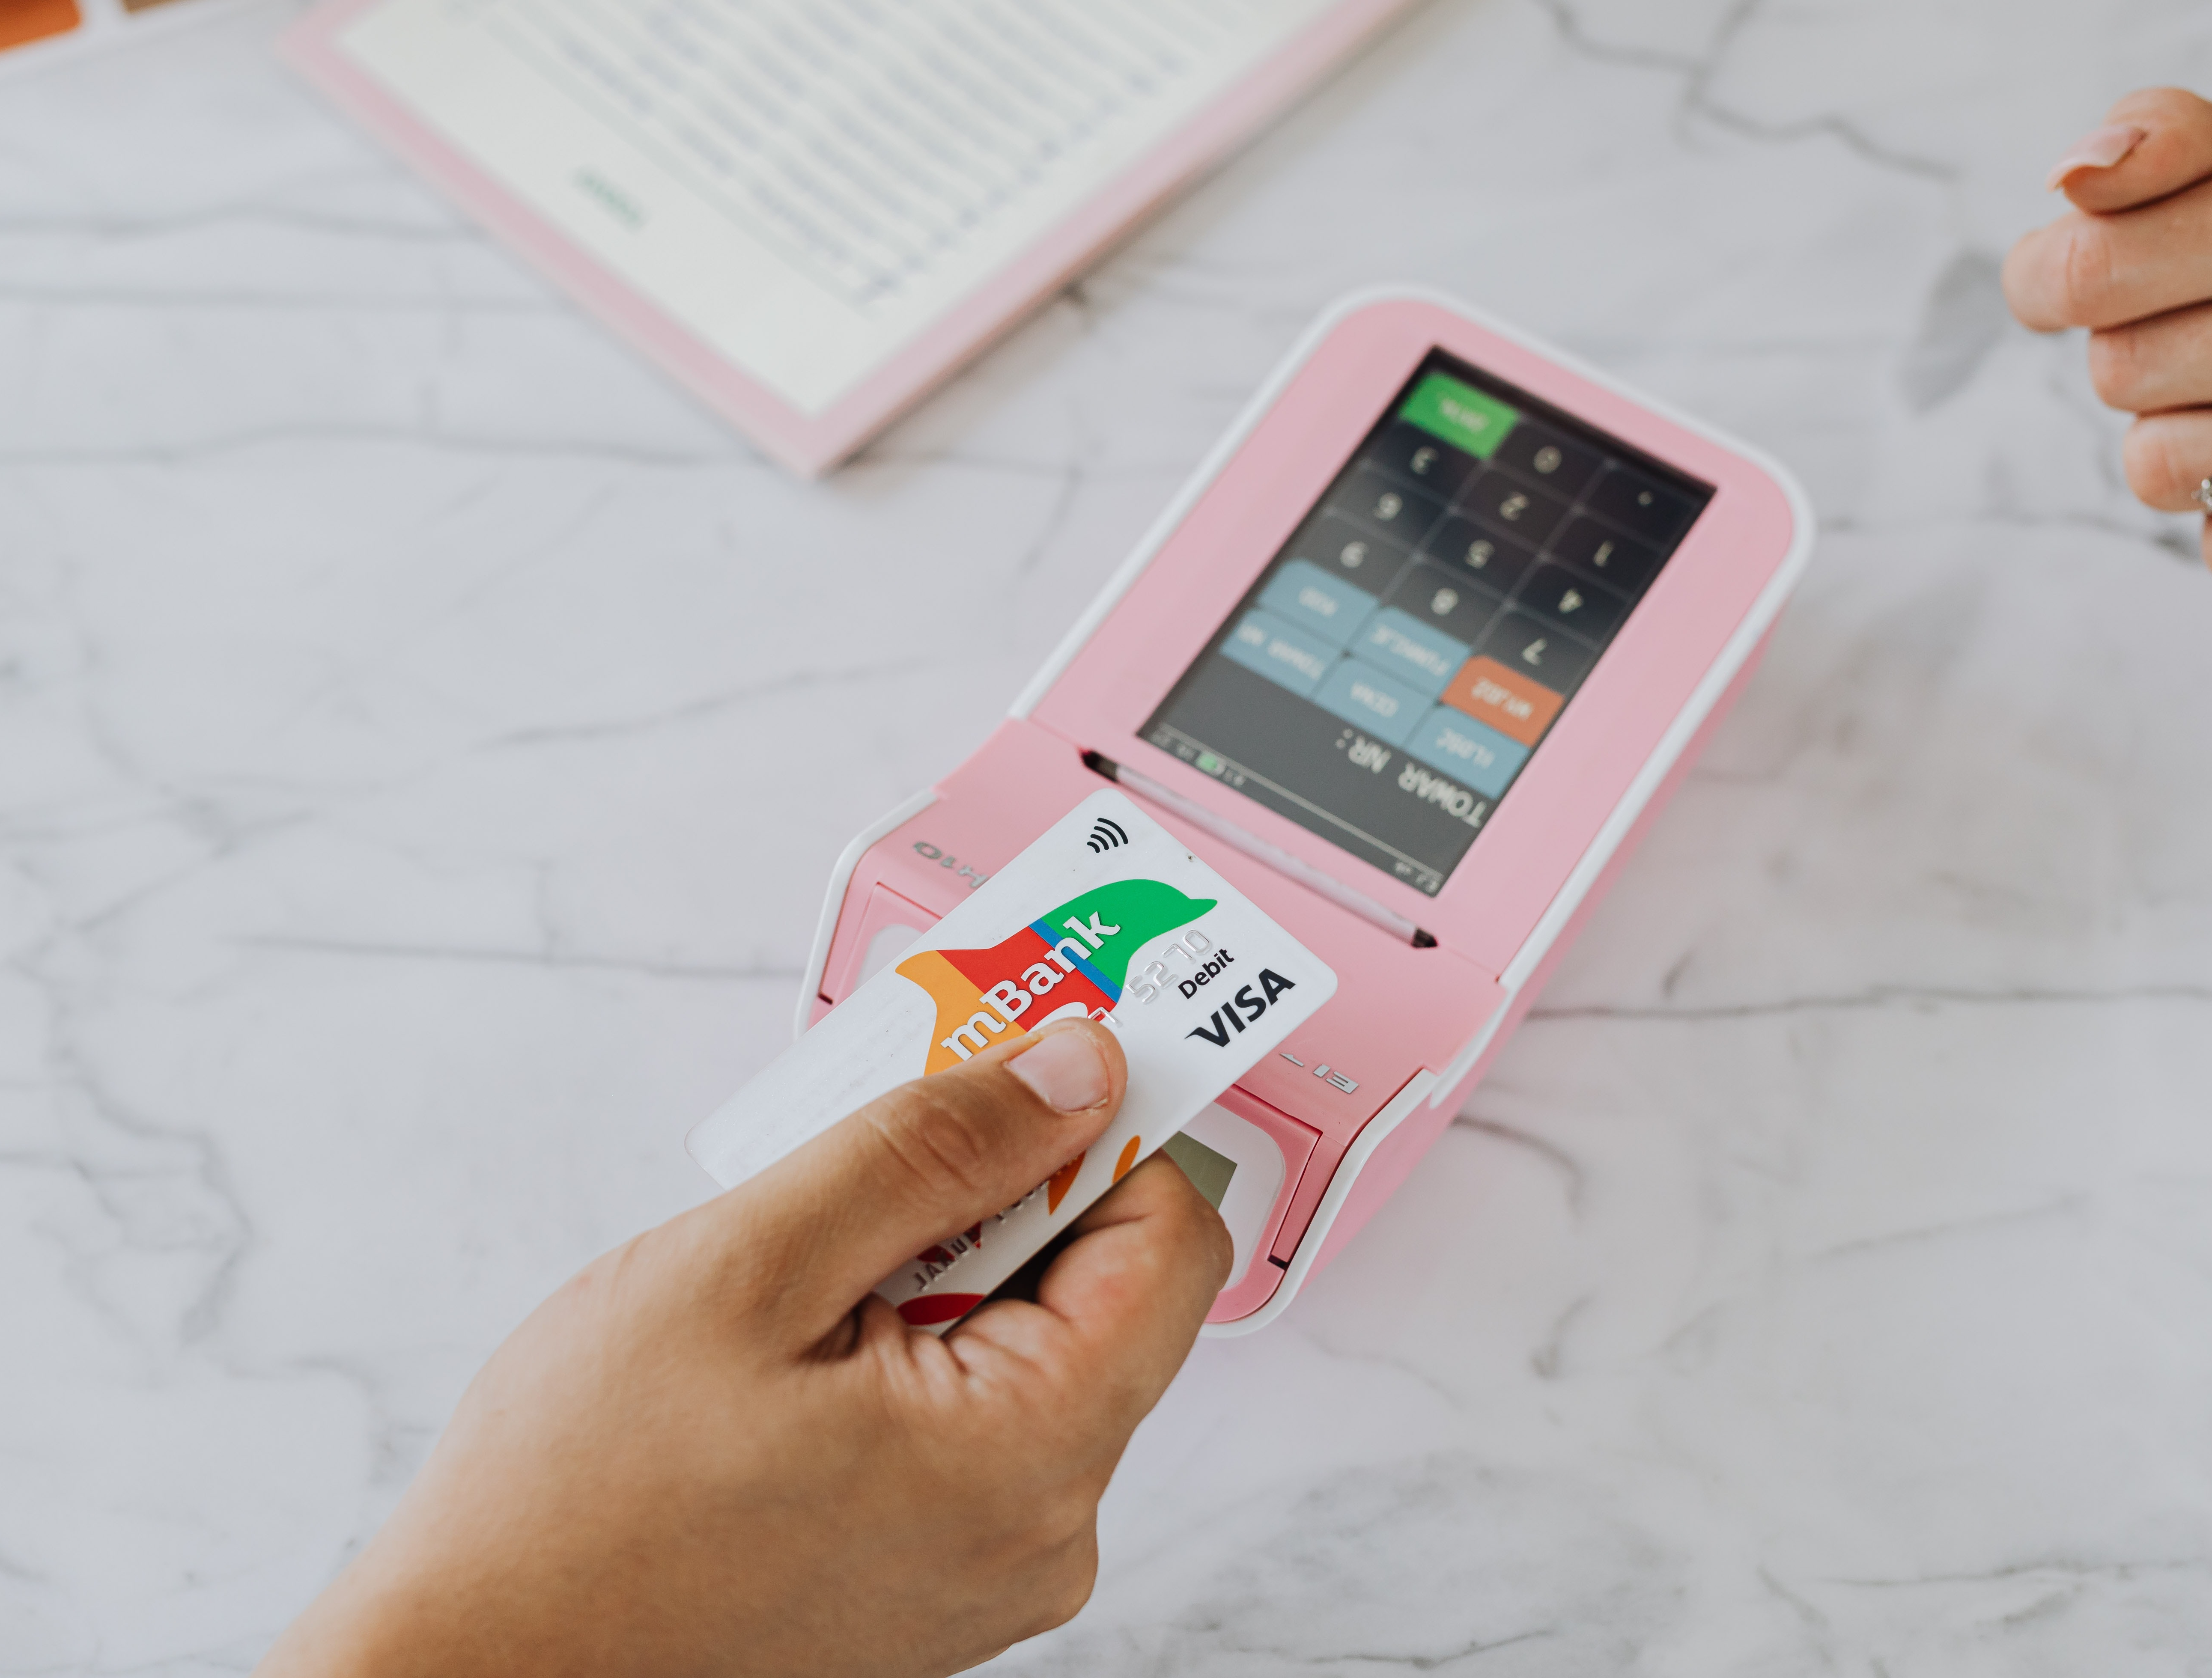
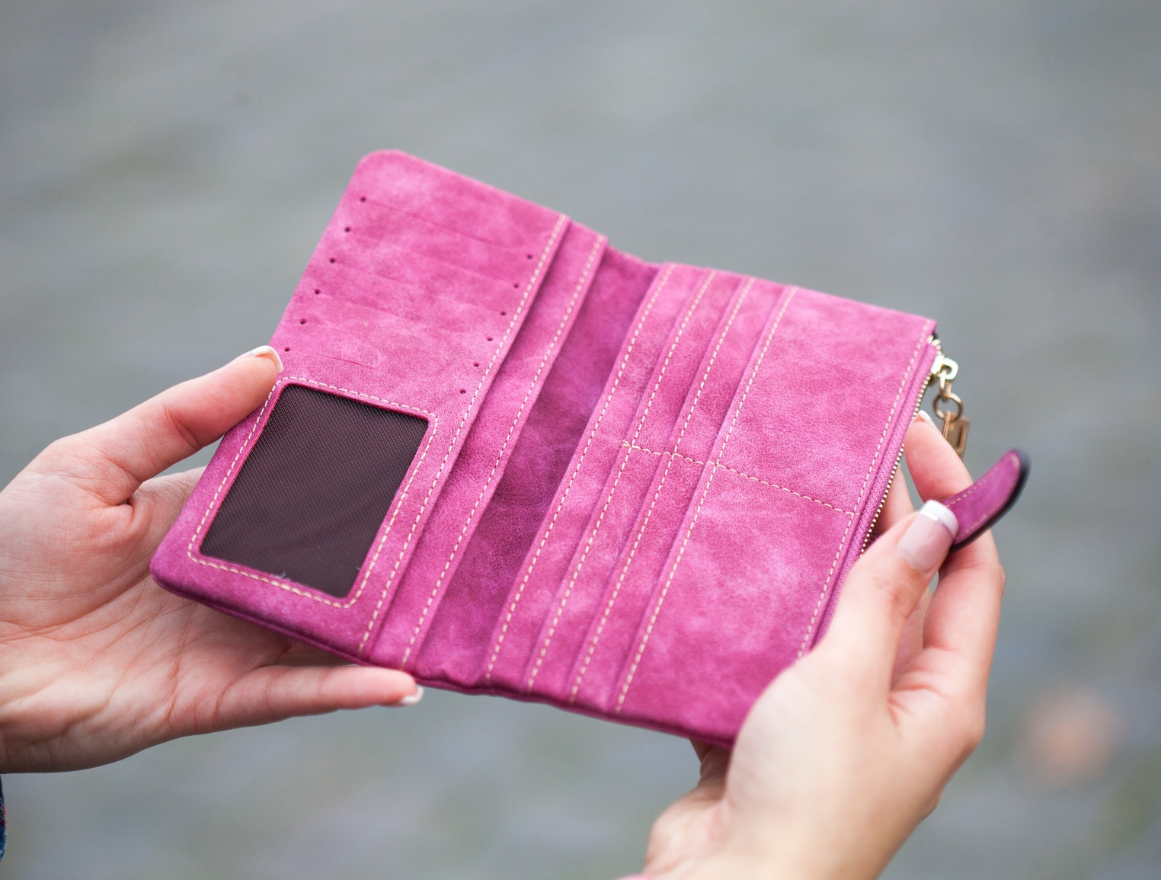
3 scenarios—CASH ONLY
"I only have $10 cash—you take cards?"
30 customers
$10 average sale
$300 in sales
30 cash customers
Average $20 purchase
$600 in sales
I have $40 in SNAP on my EBT and I heard about Double Dollars—do you do that?
10 customers
$0 in sales

Slide 9
3 scenarios—Cash & Cashless Payments
"I only have $10 cash—you take cards?"
30 customers
$40 average sale
$1200 in sales
30 cash customers
Average $20 purchase
$600 in sales
I have $40 in SNAP on my EBT and I heard about Double Dollars—do you do that?
10 customers $80/ea once doubled
$800 in sales

Slide 10
Let's compare...
$2600
Cash + Cashless
$900
Cash Only

Slide 11
But...Cashless isn't FREE!!!
# of sales @ average $ | Per transaction fee | Total $ Sale | %-based fee (Total Sales x 2.6%) | Net Fees (Transaction + % Fees) | Net Sales (Total $ Sales – Net Fees)
30 @ $10/ea | $0 | $300 | $0 | $0 | $300
30 @ $40/ea | -$3.00 ($.10 x 30 sales) | $1200 | -$31.20 | -$34.20 | $1165.80
35 @ $10/ea | -$3.50 ($.10 x 35 sales) | $350 | -$9.10 | -$12.60 | $337.40
50 @ $40 ea | -$5.00 ($.10 x 50 sales) | $2000 | -$52.00 | -$57.00 | $1943.00
Cash Only
Cashless Larger Avg. Sale
Cashless More Transactions
Cashless Larger Sale & More Transactions

Slide 12
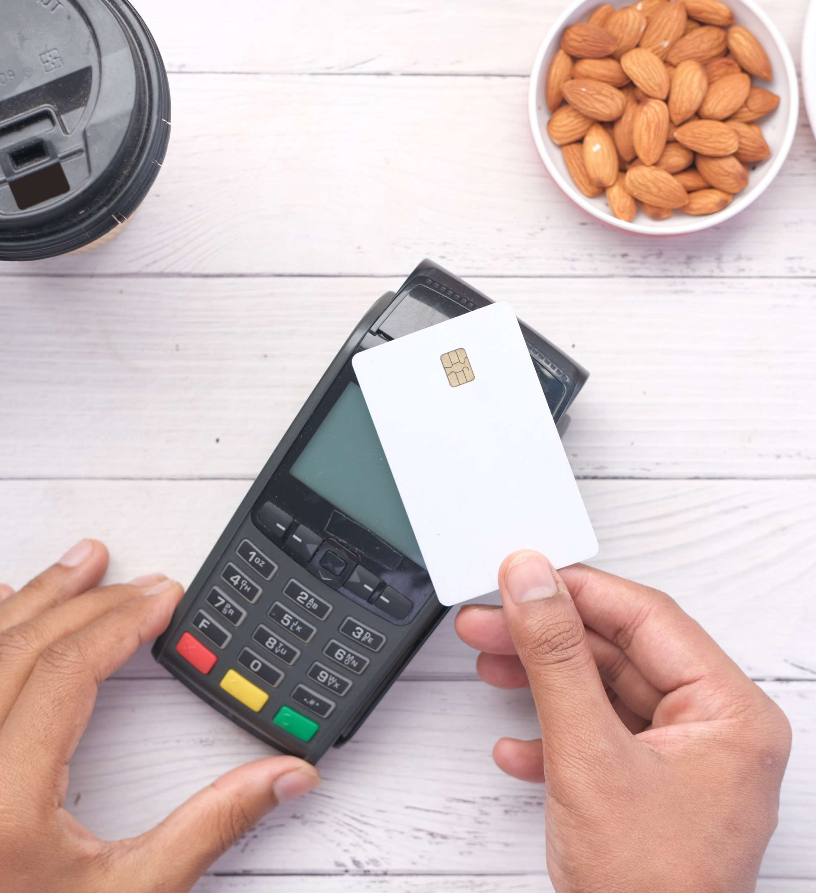
How To Accept Credit & Debit Cards
Purchase a mobile card reader
Plug the card reader into your smartphone
Swipe, insert, tap, or key-in card numbers (depending on the card reader model)
Notes:
So how to accept cards. First, you will need a mobile card reader if you do not already have one. You will plug in this card reader to your smartphone or some of them are stand alone styles which don’t attach to your phone. You will total up the customers purchase and they will swipe, insert, tap, et their cards. And it can be that easy!

Slide 13
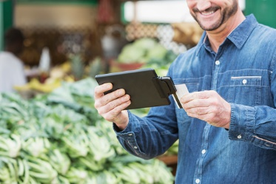
Recap: What is the Way Forward?
With plastic currency being the preferred payment method of many consumers, accepting credit and debit cards is almost non-negotiable
There is not as much of a ceiling to consumer purchases – step on the gas!
Notes:
So to re-cap. With plastic currency being the preferred payment method of many consumers, accepting credit and debit cards is almost non-negotiable to not accept it. Plus, with the added theory behind consumer purchasing with cards – it could be a payment method for you to explore for sure.

Slide 14
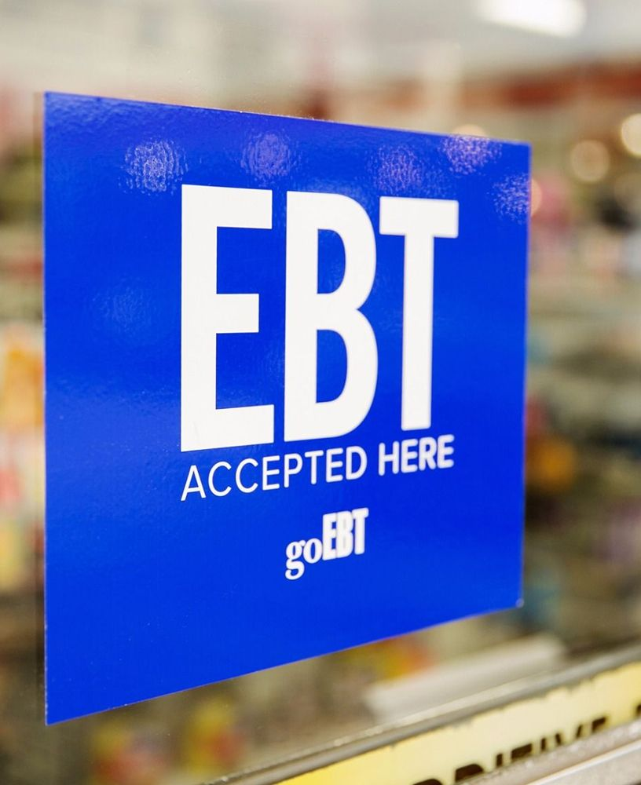
I’ve Heard Of EBT, But What Is It?
EBT stands for Electronic Benefits Transfer
It is the “system” that allows a SNAP participant to pay for their food using SNAP benefits
Notes:
So before we talk about credit and debit cards, I wanted to address a form of payment that might or might not be familiar to you. Have people heard of EBT or Snap benefits? They are quite common at grocery stores but are making headway in the famers marketing and DTC space. EBT stands for Electronic Benefits Transfer. It is the system that allows a SNAP participant to pay for their food items using their SNAP benefits. Often time you can find these little signs where EBT cards are accepted.

Slide 15
How EBT Works
At the beginning of each month, funds are deposited into an individual’s SNAP account which is linked to their EBT card
Beneficiaries use their EBT card to spend their monthly amount on SNAP-eligible food items at SNAP-authorized retailers
Notes:
So a little back information to explain how EBT works: at the beginning of each month, funds are deposited into an individual’s SNAP account which is linked to their EBT card. SNAP beneficiaries use their EBT card to spend their monthly allowance on SNAP-eligible food items at SNAP-authorized retailers. An EBT card works similar to the debit and credit cards we use to buy things, except our are linked to our bank accounts and an EBT card is linked to a SNAP account. So why am I talking about this? Because producers can accept EBT as a form of payment.

Slide 16
Accepting EBT at the Market
SNAP customers redeem their benefits by swiping their EBT card on a point-of-sale (POS) terminal at the market in exchange for tokens or a paper receipt
Farmers and vendors can become authorized to administer their own SNAP program, but it’s most common for markets to use a centralized POS
Notes:
So SNAP users can redeem their snap benefits at a terminal at the market in exchange for tokens or a paper receipt. Then they take these receipts or token and use them at different vendor’s stands. Vendors will be paid out for their tokens or paper receipts. Most of the time the farmers market as a whole will be certified to accept EBT as a form of payment; however, farmers and individual vendors can become authorized but it is more common to use a centralized point of sale system.

Slide 17
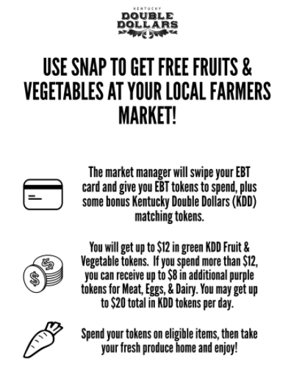
Accepting EBT at the Market
Markets that are part of the KY Double Dollars program use this system
The KYDD program helps remove obstacles for consumers and farmers with hopes to increase the purchase and consumption of locally-grown food

Slide 18
How Can Accepting EBT/Snap Be a Benefit to You?
EBT cards look and act just like a regular credit or debit card. Allowing consumers to use their card at your farm stand expands the reach of your product and sales
Accepting EBT or other supplemental nutrition assistance forms of payment allows consumers to spend money on fresh produce from the community, rather than store-bought items
Notes:
So let’s talk about why it could be a god idea to accept EBT. Like we talked about, EBT cards look and act exactly like a regular credit or debit card – except for the token exchange part. If you have your own terminal that accepts EBT cards, they will look and act just like a regular debit or credit card. And a side note, this is partially done to release some of the stigmatism that can come with participating in a supplemental income or food stamp program. Nevertheless, allowing consumers to use their card or tokens at your farm stands expands the reach of your product and sales. Accepting EBT or other supplemental nutrition assistance forms of payment (like WIC or the senior farmers market voucher) allows consumers to spend money on fresh produce from the community, rather than store-bought items. It is very easy to use SNAP benefits at the grocery store, but we want to keep that money in our local economy right? So making it a little easier for consumers to spend their federal funding dollars keeps money in the local community rather than in chain-type stores.

Slide 19
What If My Market Doesn’t Accept EBT?
Talk to your market manager about the benefits of accepting EBT and the positive impact it can have on both yourself and community members!
Organizations like Community Farm Alliance have grant programs that can cover the cost of EBT accepting POS systems for your market
The CFA Farmers Market Grant program will open again for 2023
Notes:
So what if your market doesn’t accept EBT or have a centralized point of sale system for customers to use? It could be a good idea to talk to your market manager about the benefits of accepting EBT and the positive impact it can have on both yourself and community members! There are a organizations in Kentucky that have grant programs which can cover the cost of EBT accepting POS systems for your market, like Community Farm Alliance. I put a little plug in for their grant program – it is closed for 2022 but will reopen for 2023 applications.

Slide 20
What If My Market Doesn’t Accept EBT?
The KDA works closely with EBT/SNAP benefits at farmers markets. A helpful contact:
Sharon Spencer
Direct Farm Marketing
Sharon.Spencer@kda.gov
(502) 782-4127

Slide 21
Recap: What is the Way Forward?
Accepting EBT cards can be confusing, but there are ways to accept them at your farmers market
Accepting EBT allows you to reach another set of consumers
Each year program participants spend roughly $70 billion in SNAP benefits, including more than $22.4 million at farmers markets in 2017
Notes:
So in summary, accepting Ebt can be confusing for some of us. It was confusing for me at first! But accepting EBT allows you to reach another set of consumers. The statistic I have here is very dated, but just for an idea: in 2017 program participants spent 22.4 million at farmers markets. That’s over 30% of the total snap spending amount for that year. So, there is a lot of potential here.

Slide 22
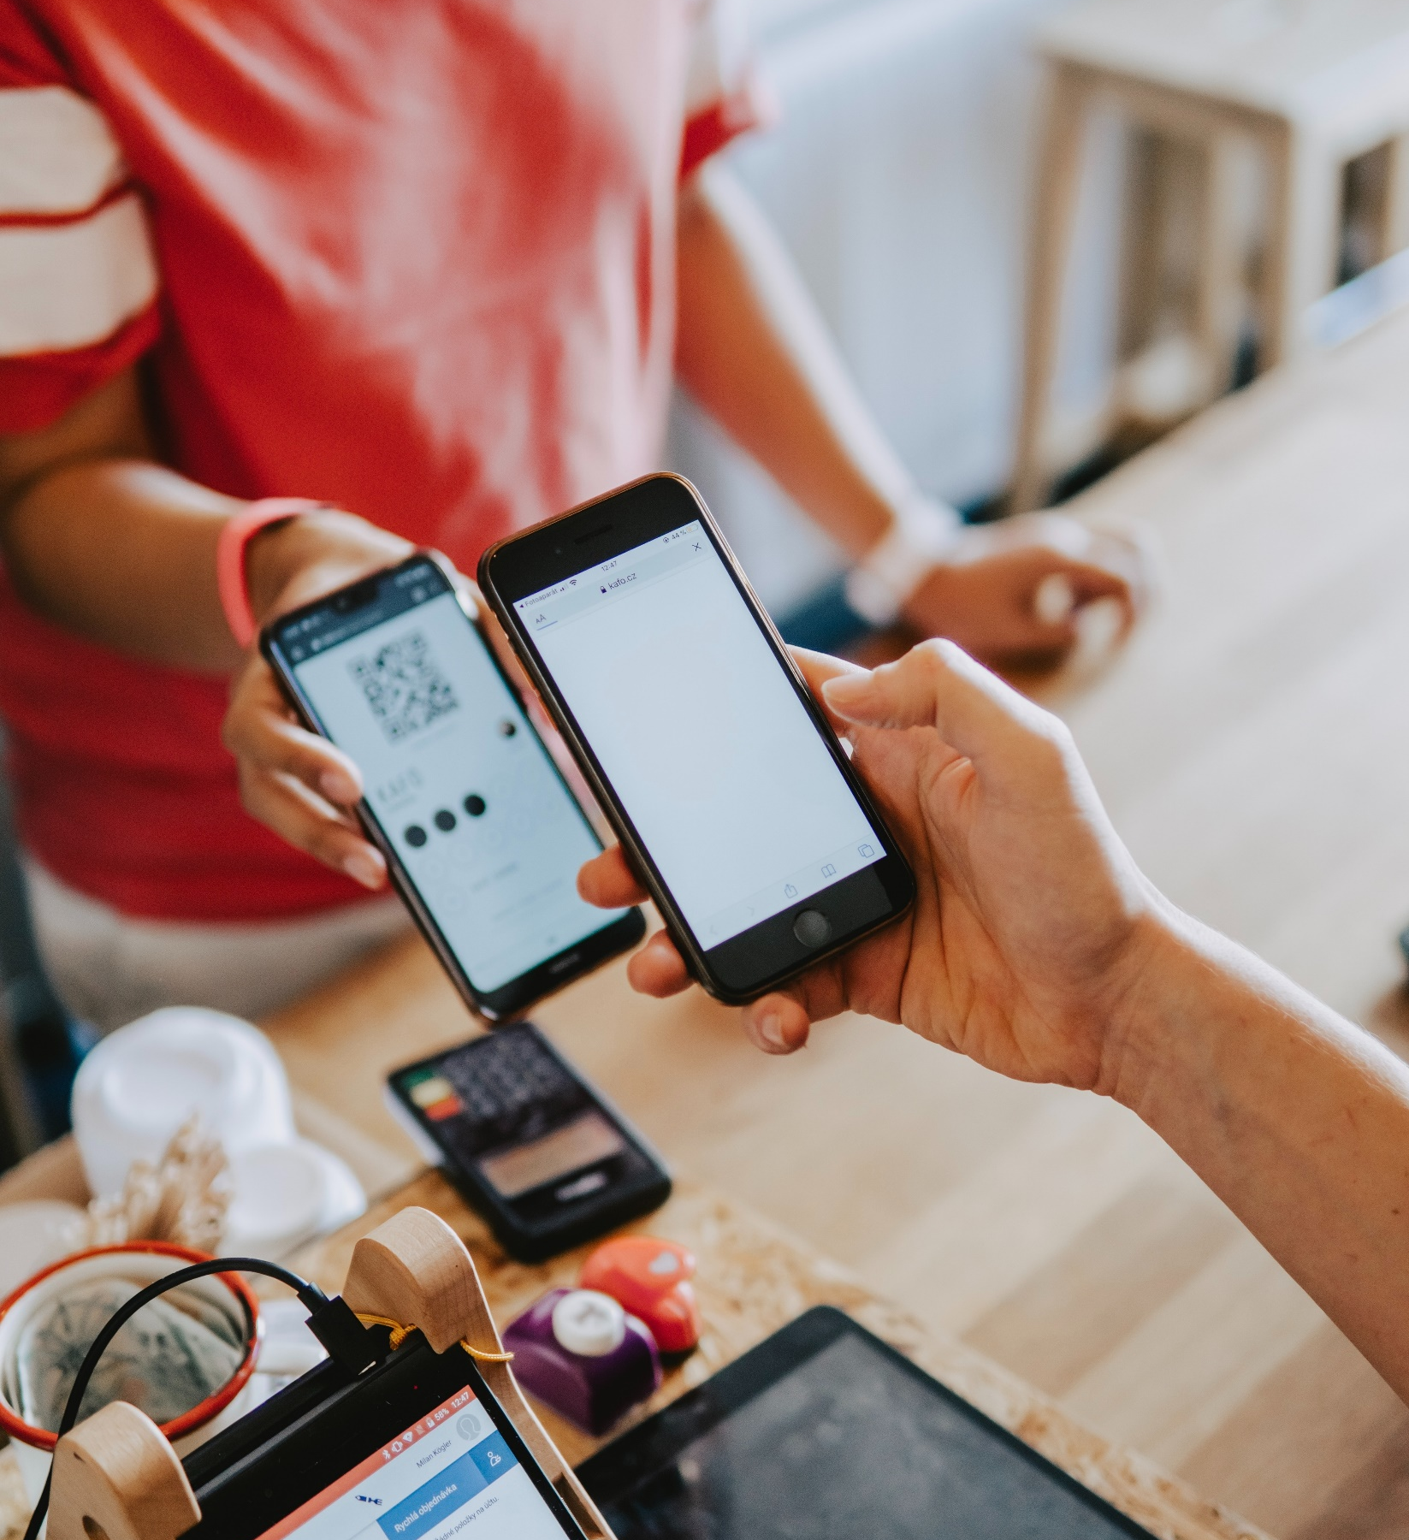
Gift Cards
A payment type you can sell
Can be a nice “gift” item to market to consumers
Gift cards provide the opportunity for consumers to pay for products in advance
Can be as simple as a paper voucher or a more detailed e-gift card
Notes:
So net, we move on to gift cards. These are not super popular – but still a thing! Gift cards can be used just like regular forms of payments. A nice thing about gift cards is that you can market them to your customers. Lets say you have a few frequent customers that love your product and mother’s day is coming up. You could suggest the customers buy gift cards for their mothers as a gift! Kind of like hitting Two birds with one stone – you make another sale to a customer while potential creating a connection with a hopefully returning customer.
So why venture out here? well, gift cards provide the opportunity for consumers to pay for product in advance. So if you like the idea of up-front payment (kind of like how a CSA is operated) this could be an option to look into. It also doesn’t have to be super technical. Gift cards can be as simple as a piece of paper (kind of like a paper coupon) that has the amount written on it! You could also venture into e-gift cards which could just be a graphic for the consumer to show at their next checkout.

Slide 23
Brainstorming Part 2…
What types of payment could I add to my business?
What are the first steps in adding these payment types?
Notes:
So just to get us thinking and preface this conversation, I want to start with two questions. These questions just get us thinking a bit about where we are as producers in our marketing channels and what we like or don’t like about the various payment methods. So, what types of payment do you accept? Cash and cards? Just cash? Only cards through a card reader?
Let’s fill out the first part of our brainstorming worksheet. This helps us preface what we accept as payment before exploring what we could accept as payment. So, let’s ponder on this for a few more seconds and then move forward.

Slide 24
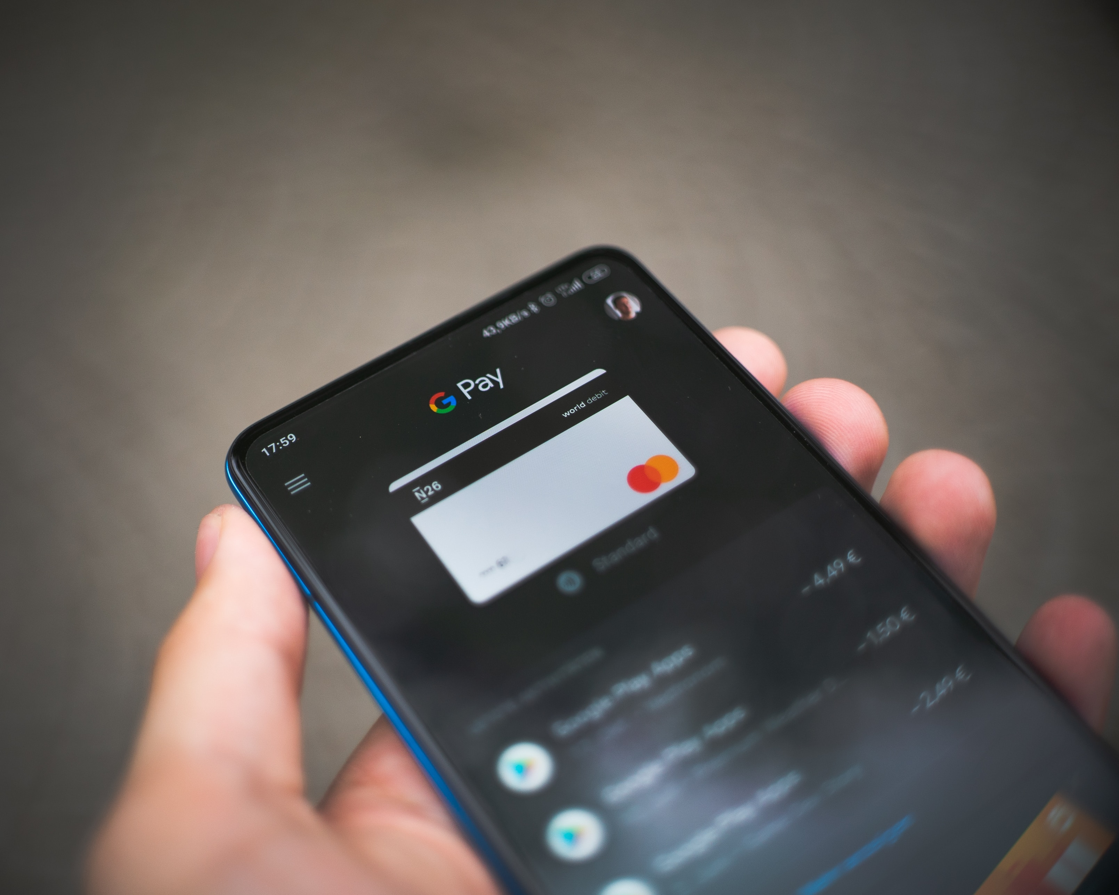
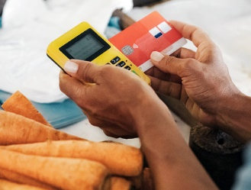

What to Walk Away With?
Accepting more than just cash reaches consumers of other payment types
Accepting cash reaches non-card-carrying consumers
Explore the options out there for your business and do what works best for you!
Notes:
So to wrap it up, accepting cash is still 100% acceptable. Accepting cash reaches your non-card-carrying consumers which are still a big part of the customer base. However, accepting more than just cash helps you reach consumers of other payment types like cards, SNAP benefits, etc. but bottom line, take this information and explore the options out there and do what works best for you!

Slide 25
Savannah Columbia
savannah.columbia@uky.edu uky.edu/ccd

